Slide 1

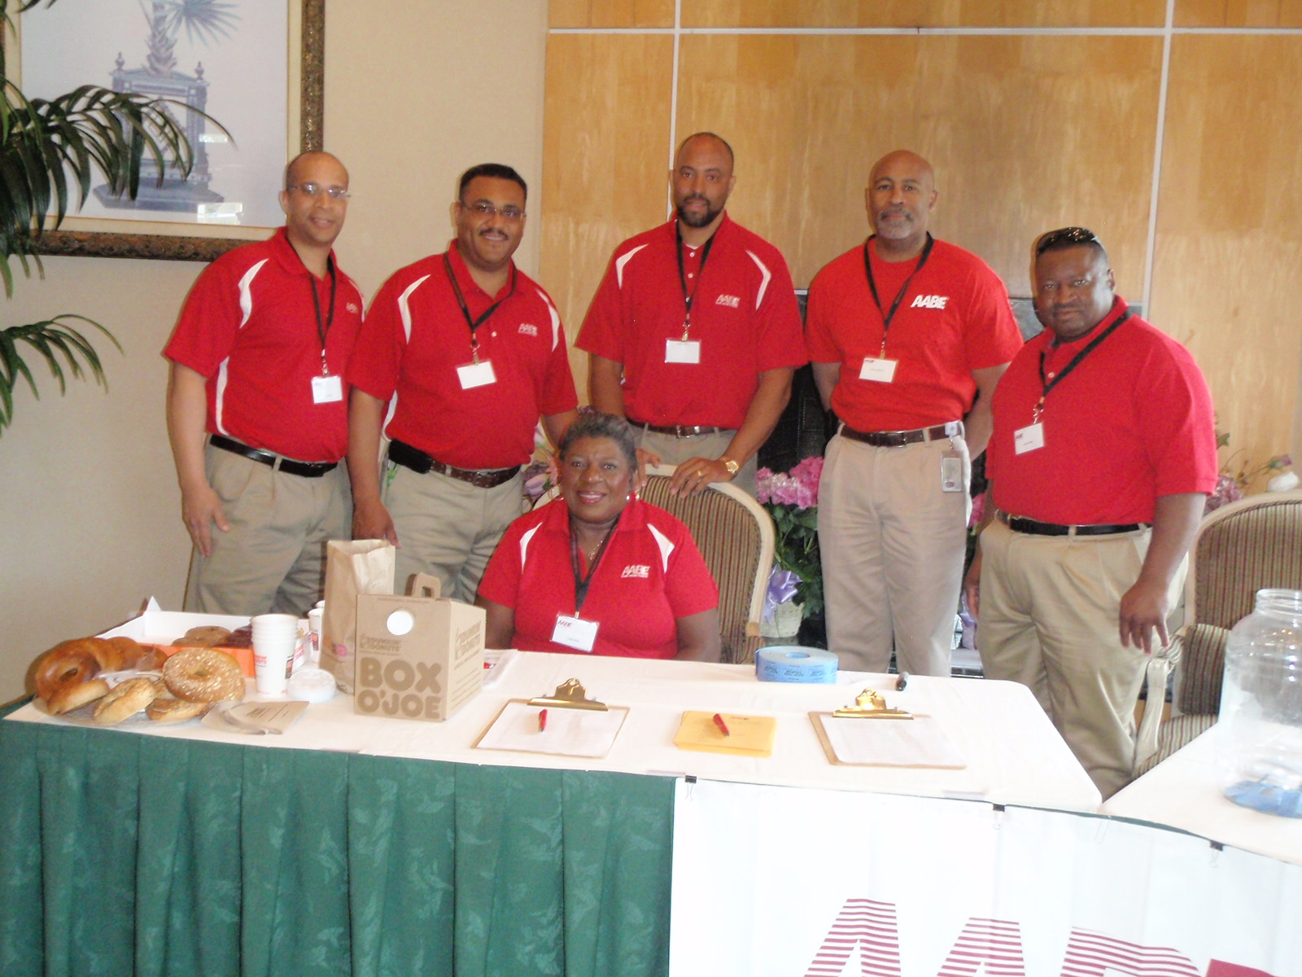
Welcome

Slide 2
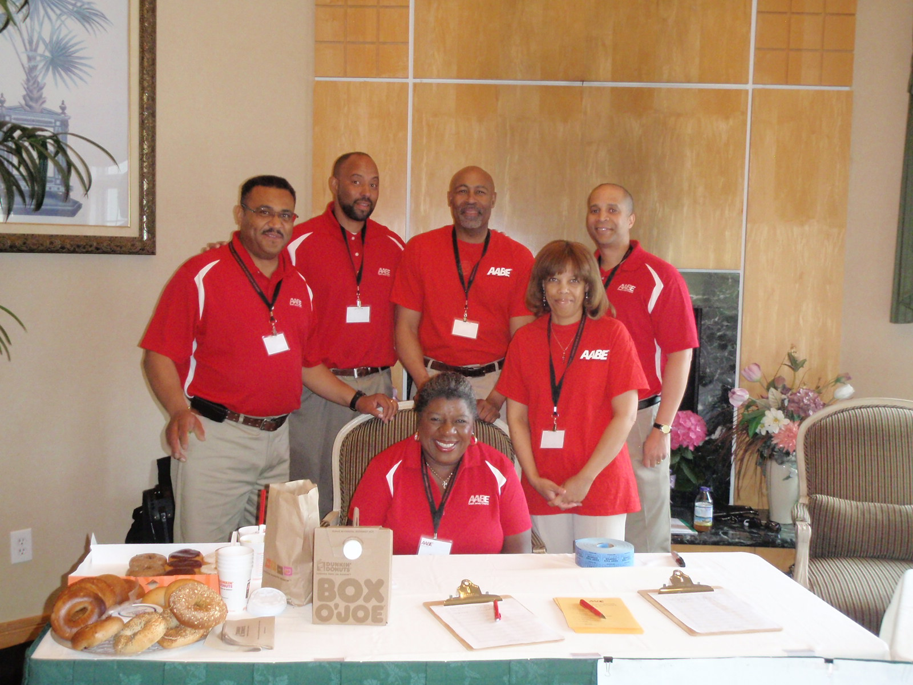
Welcome

Slide 3
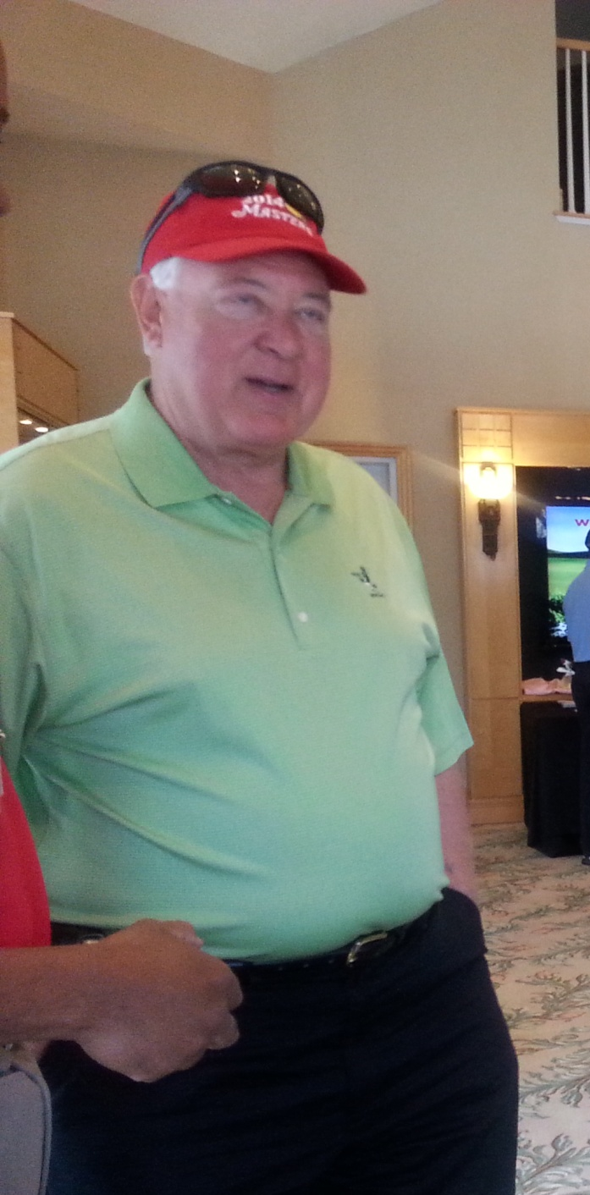
Welcome

Slide 4
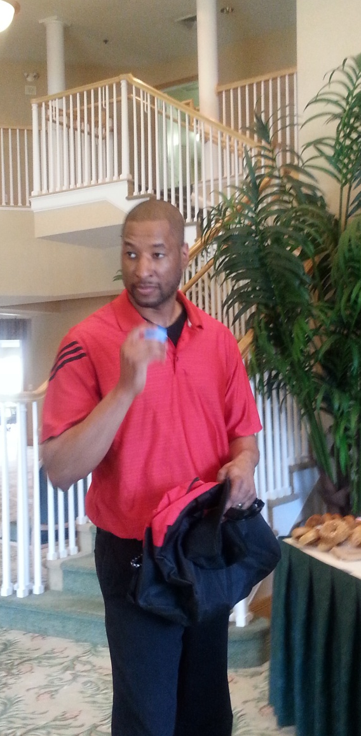
Welcome

Slide 5
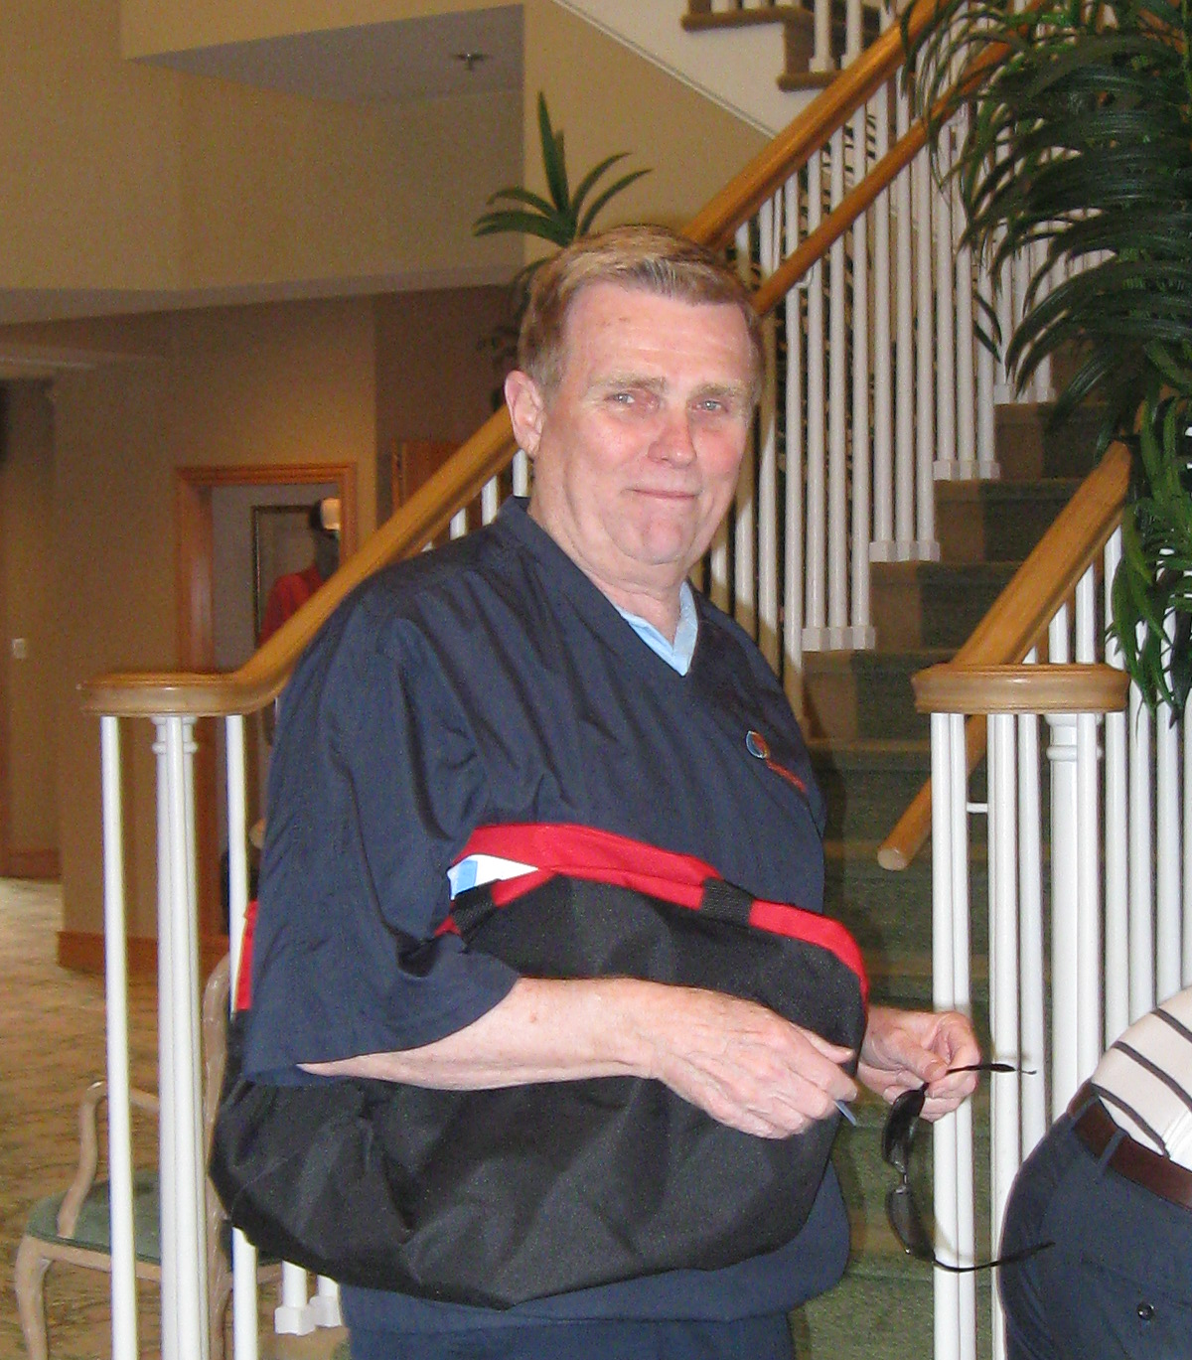
Welcome

Slide 6
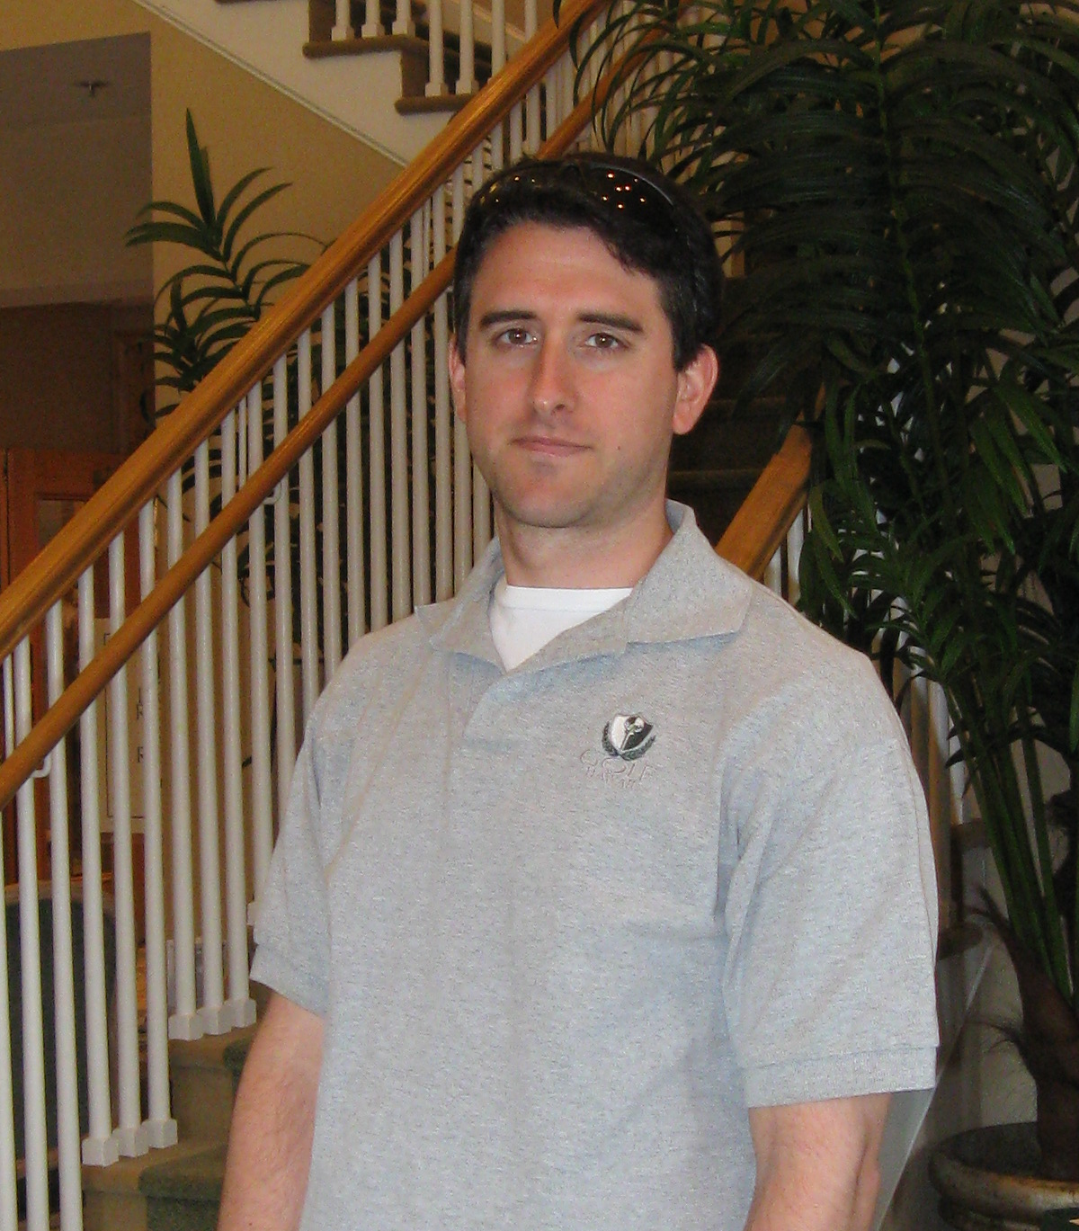
Welcome

Slide 7
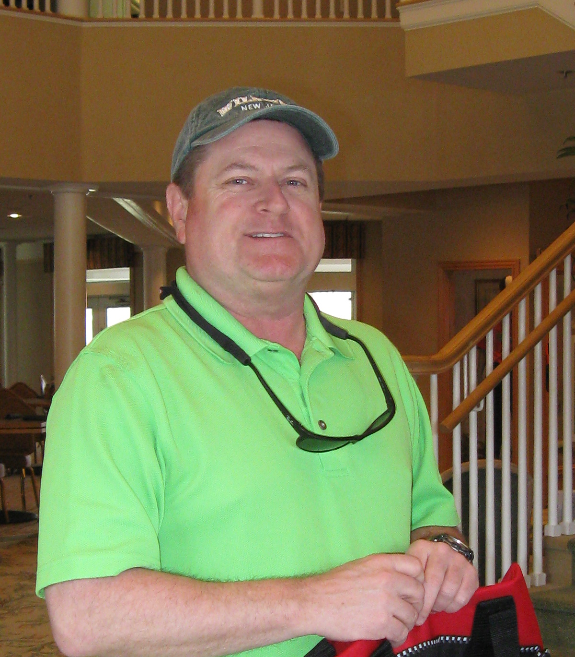
Welcome

Slide 8
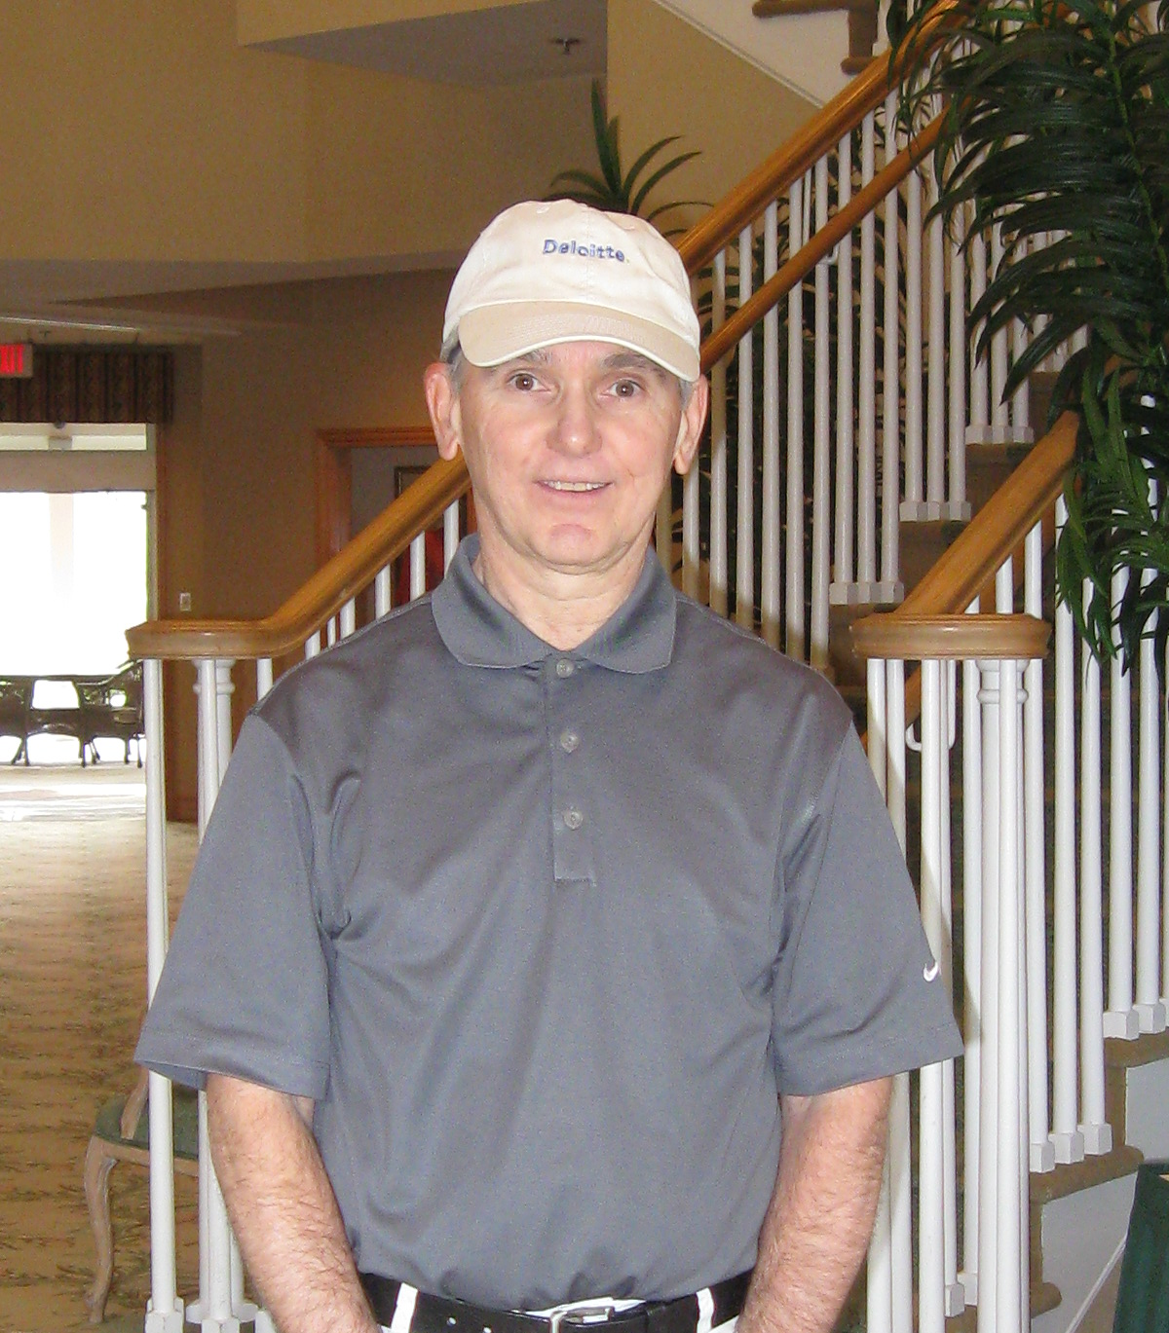
Welcome

Slide 9
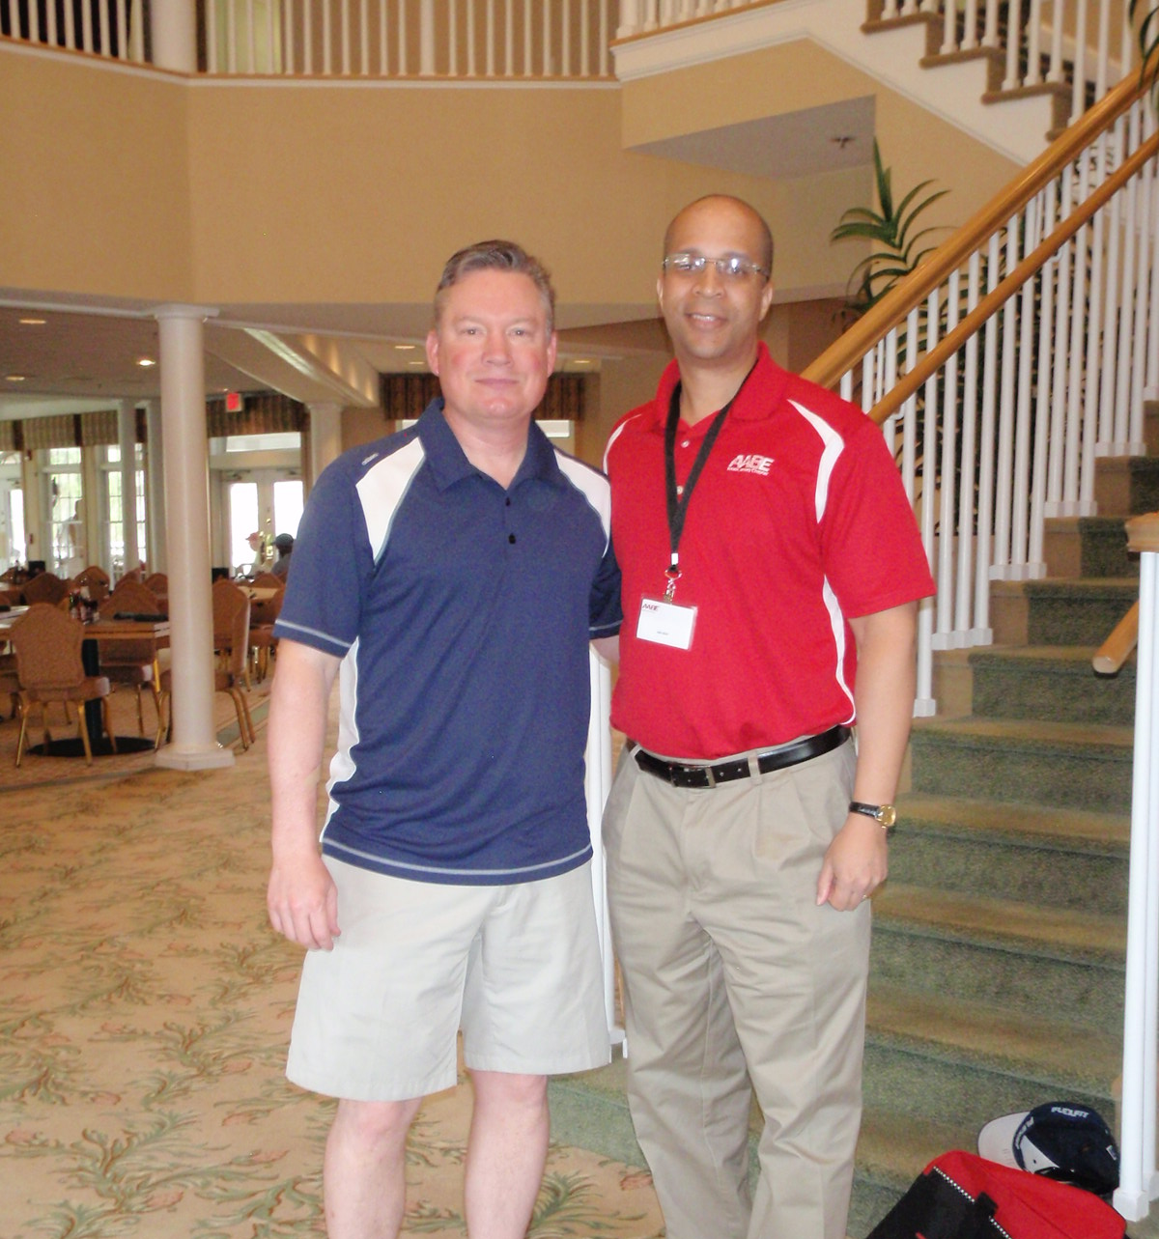
Welcome

Slide 10
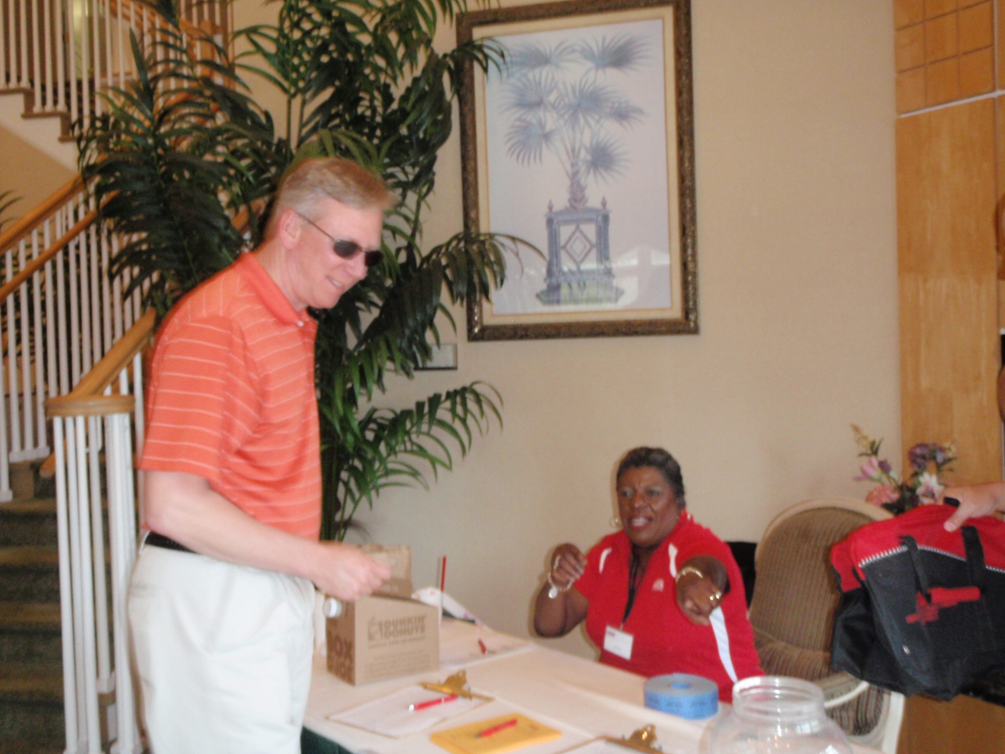
Welcome

Slide 11
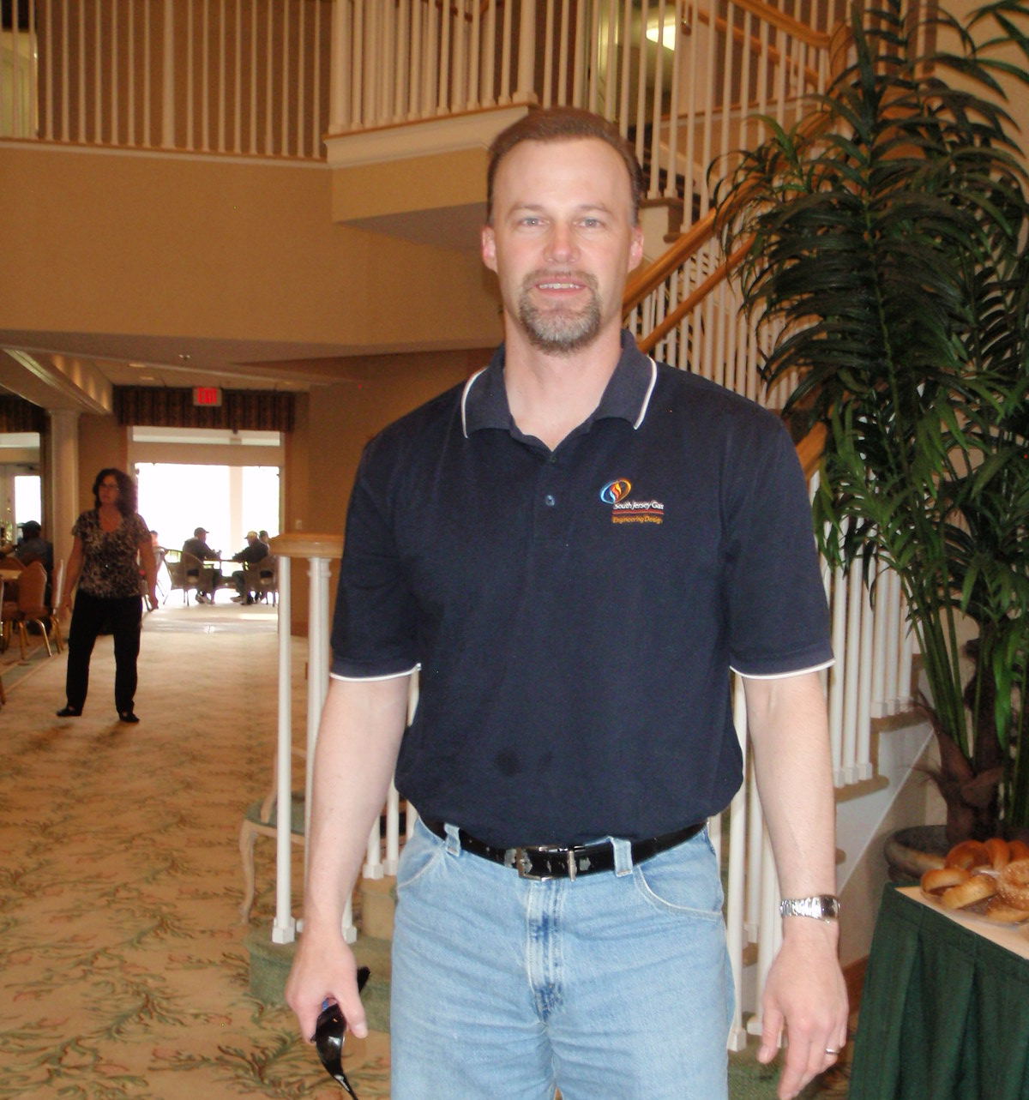
Welcome

Slide 12
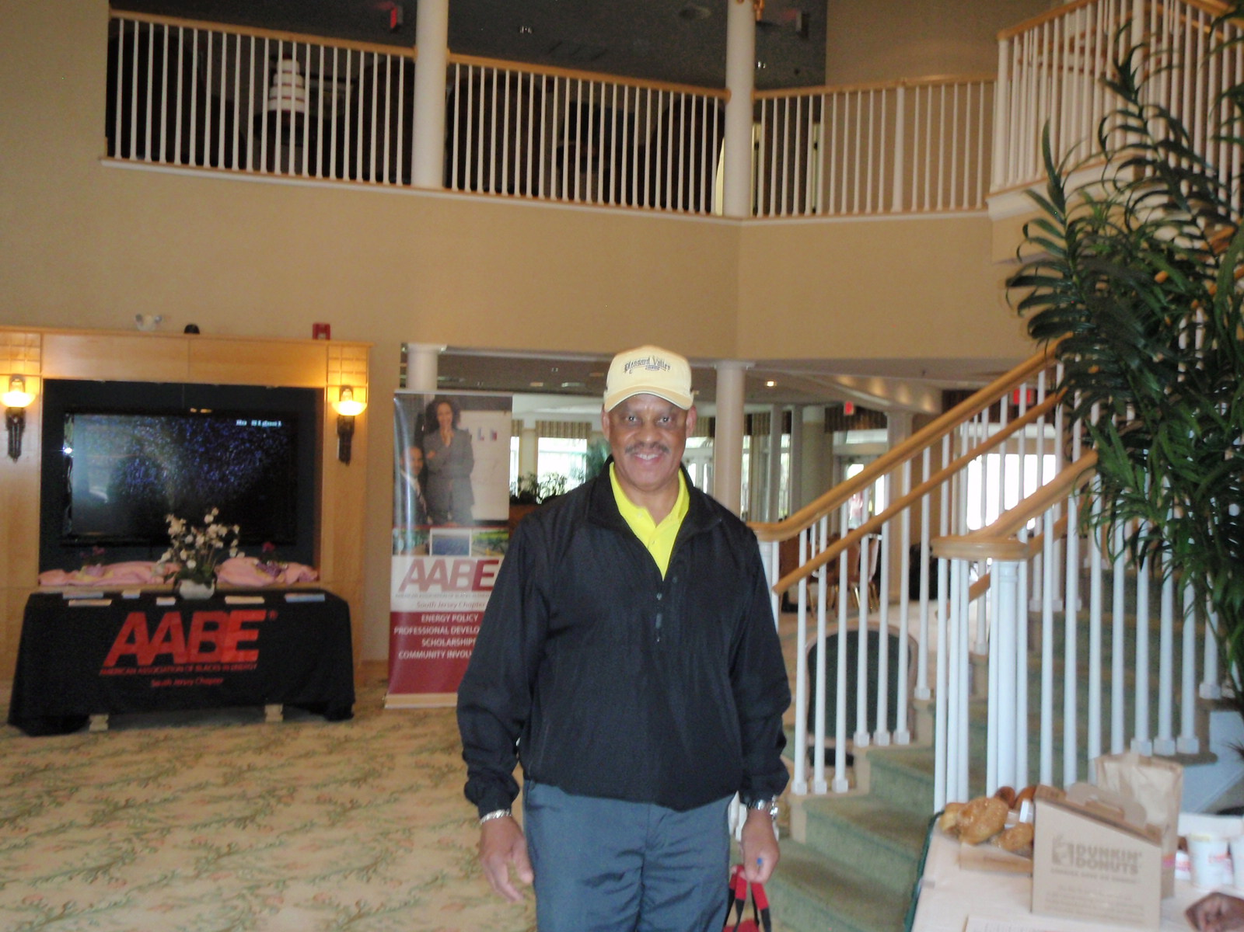
Welcome

Slide 13
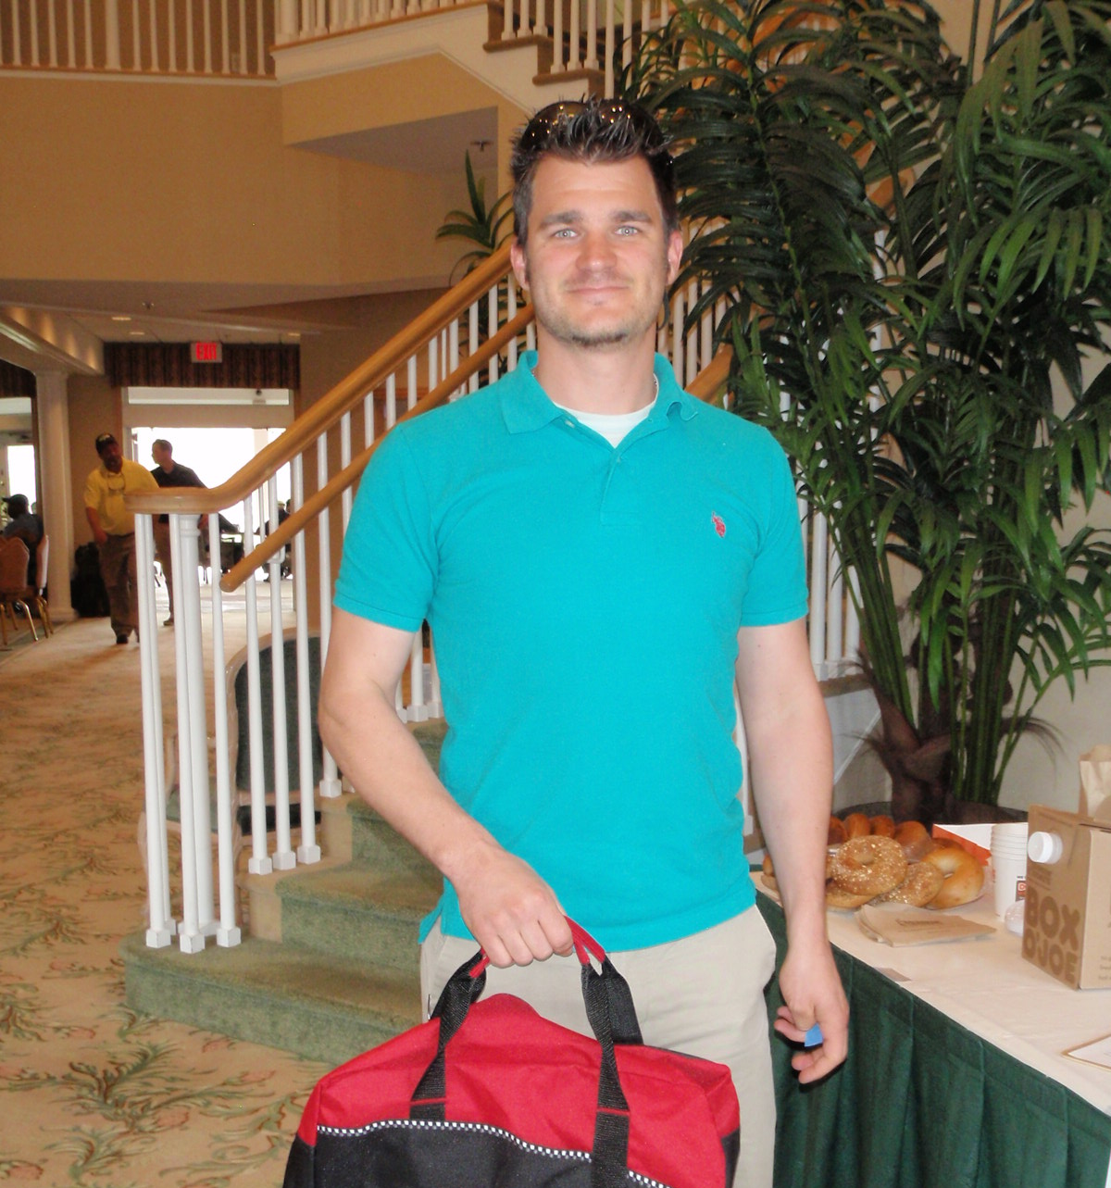
Welcome

Slide 14
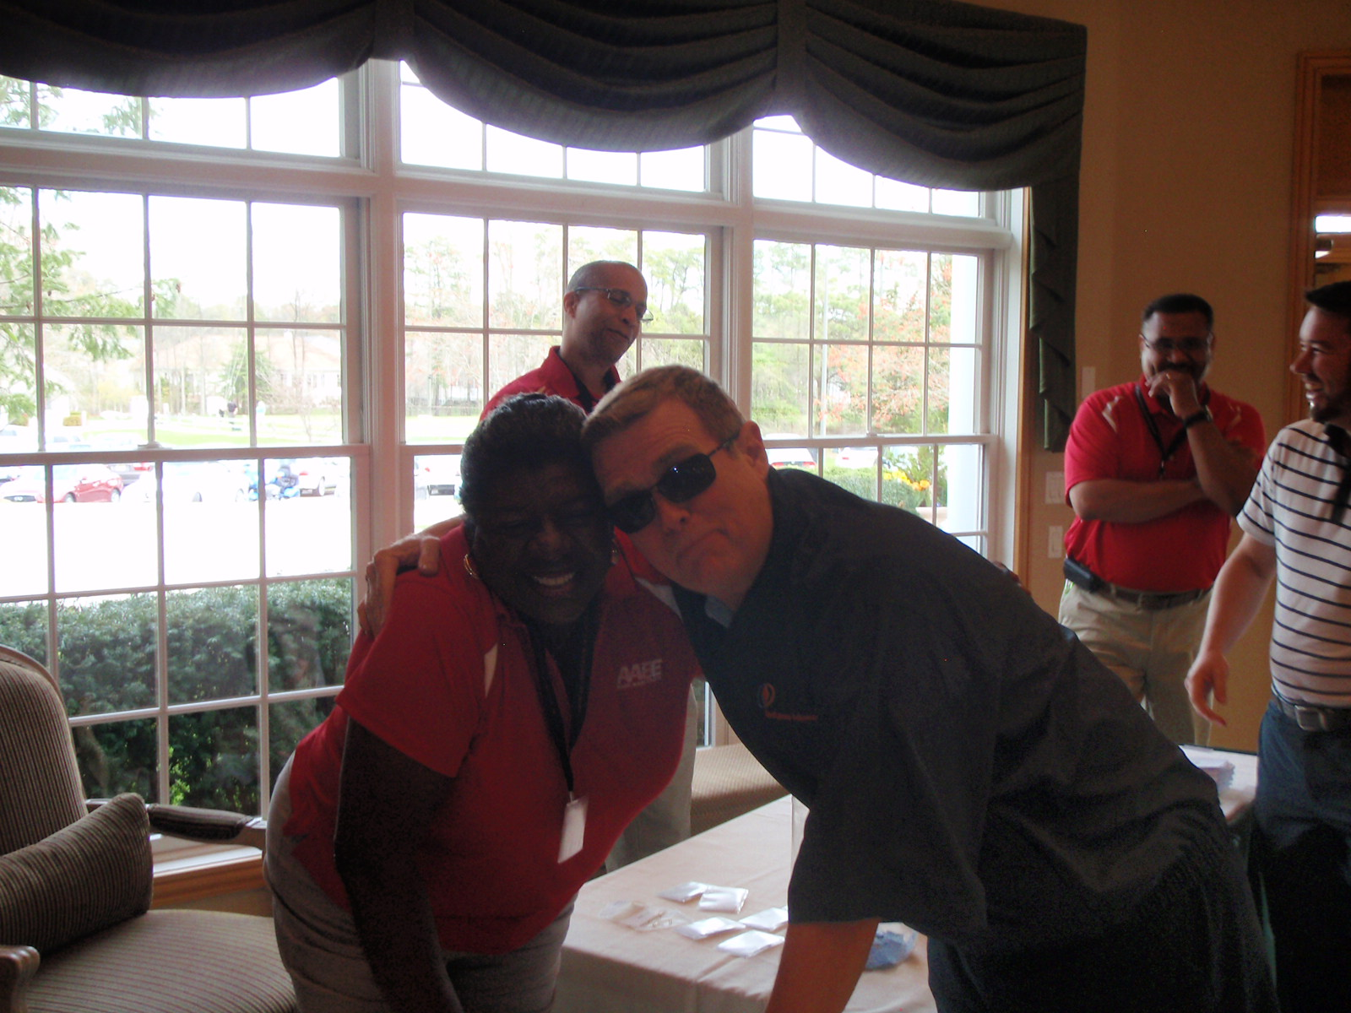
Welcome

Slide 15
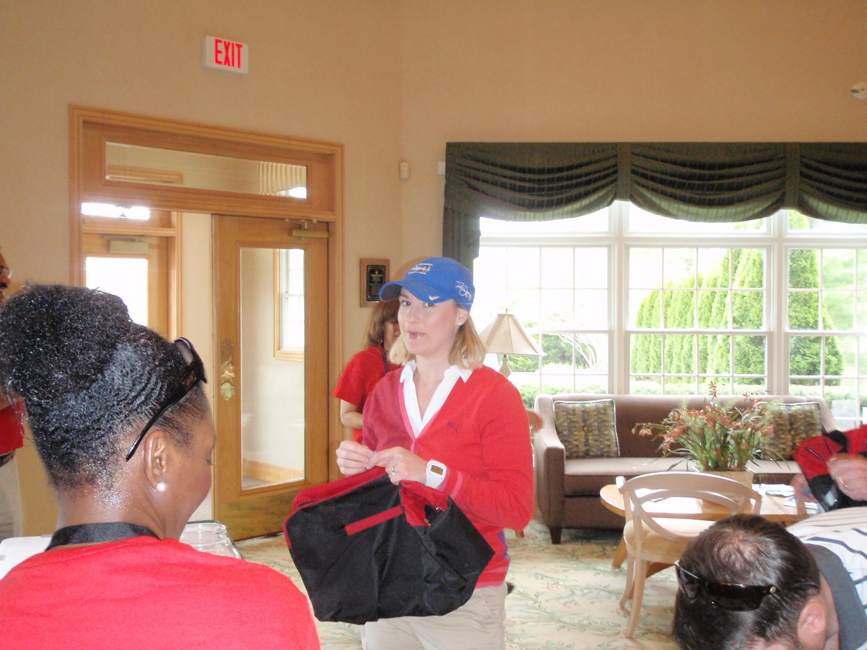
Welcome

Slide 16
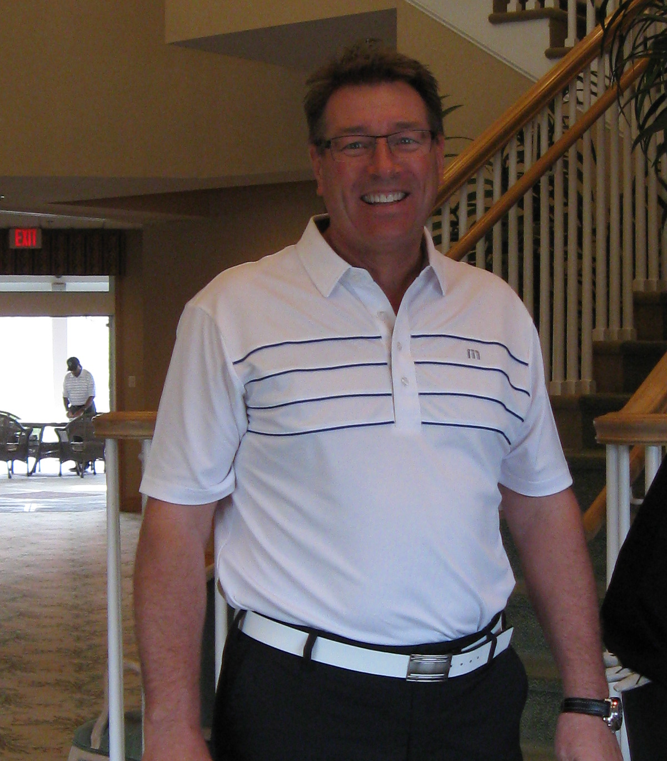
Welcome

Slide 17
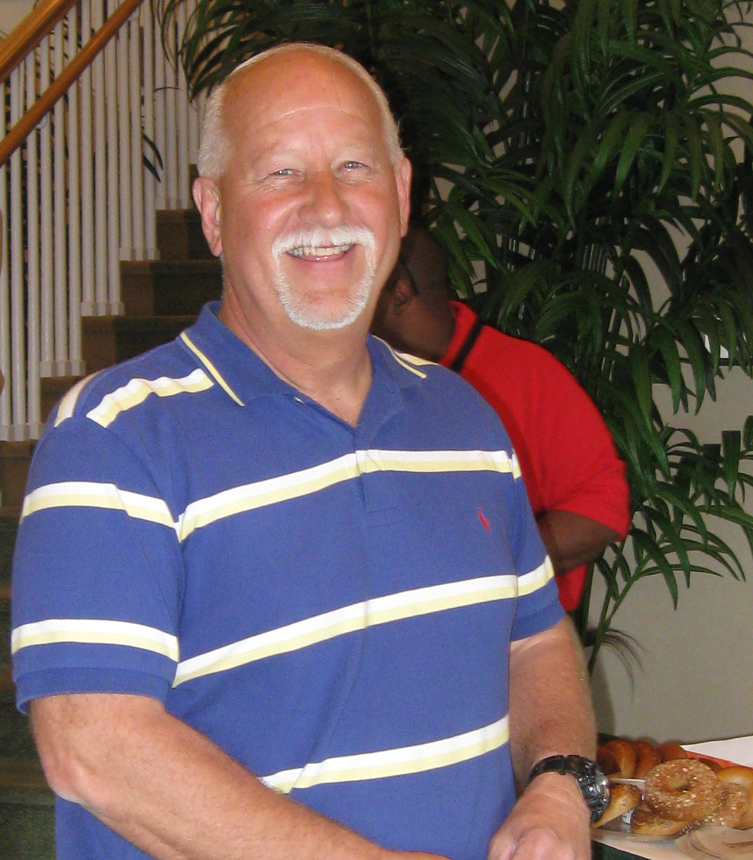
Welcome

Slide 18
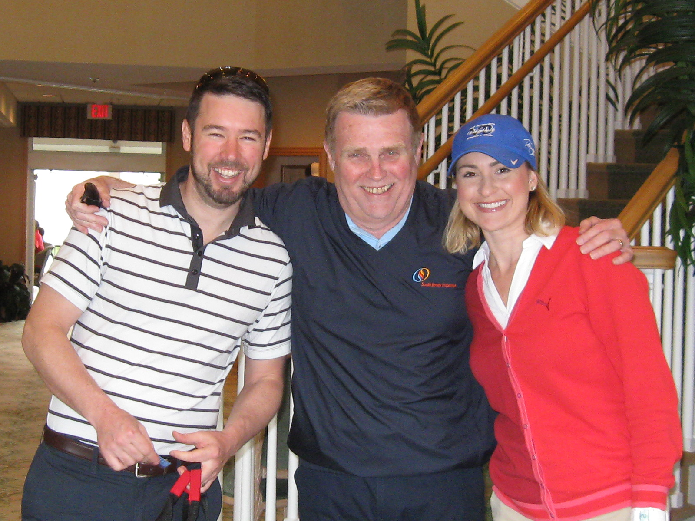
Welcome

Slide 19
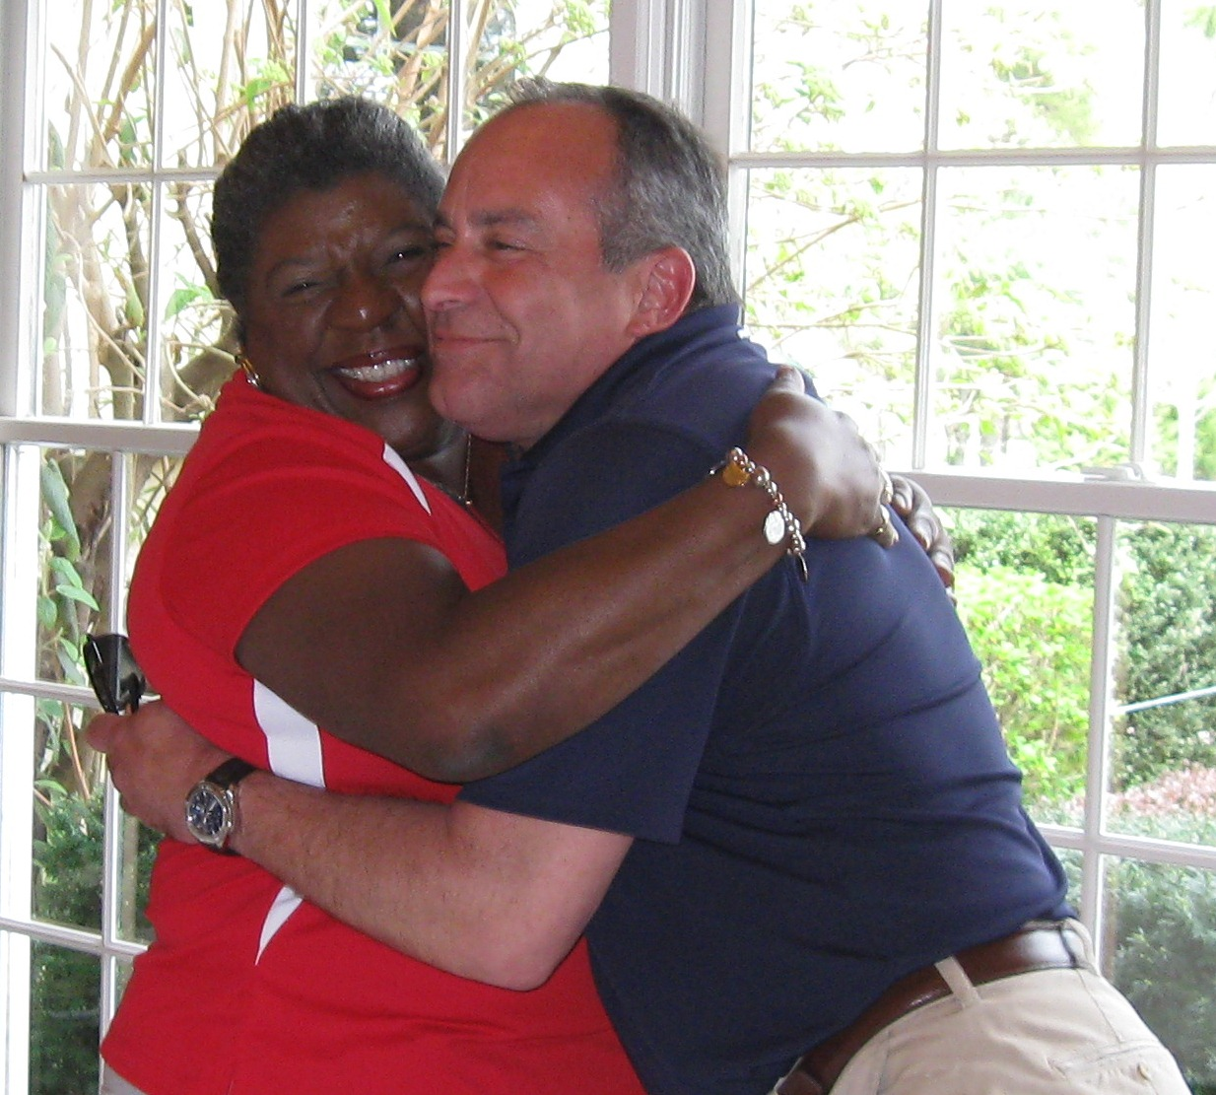
Welcome

Slide 20
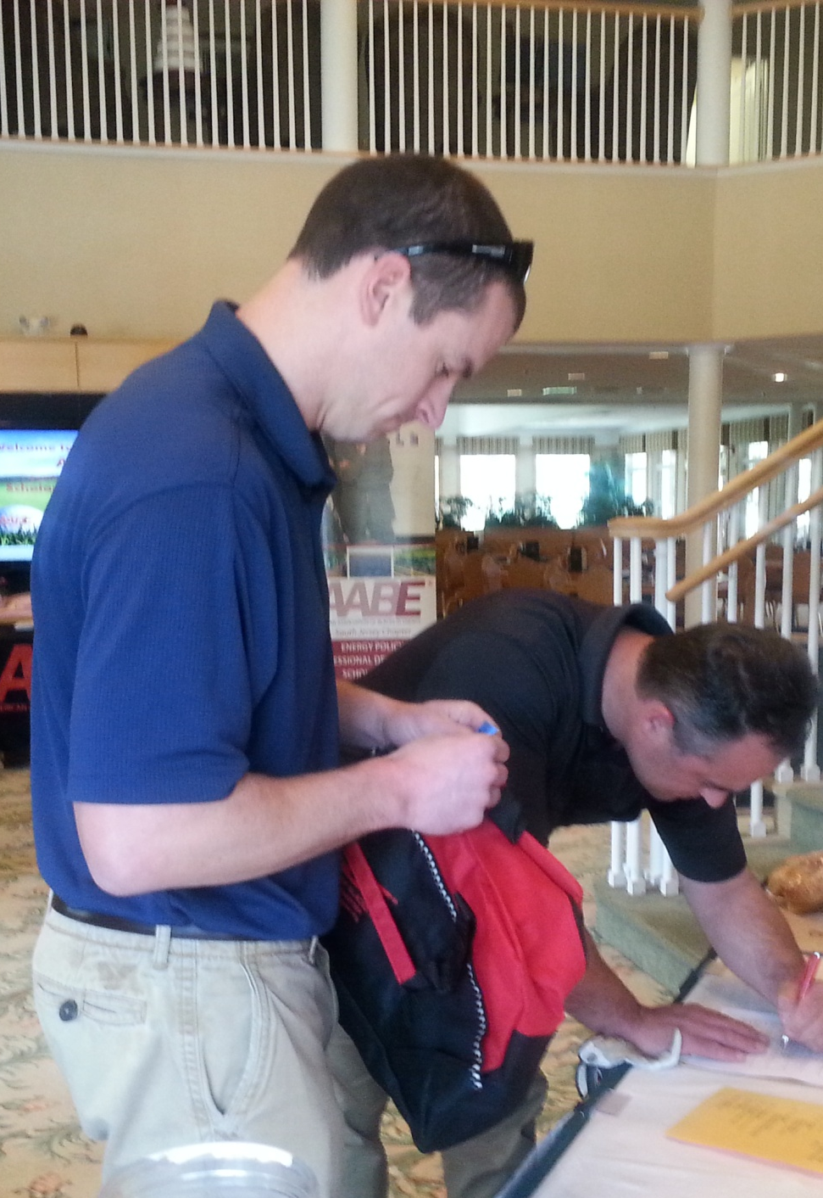
Welcome

Slide 21
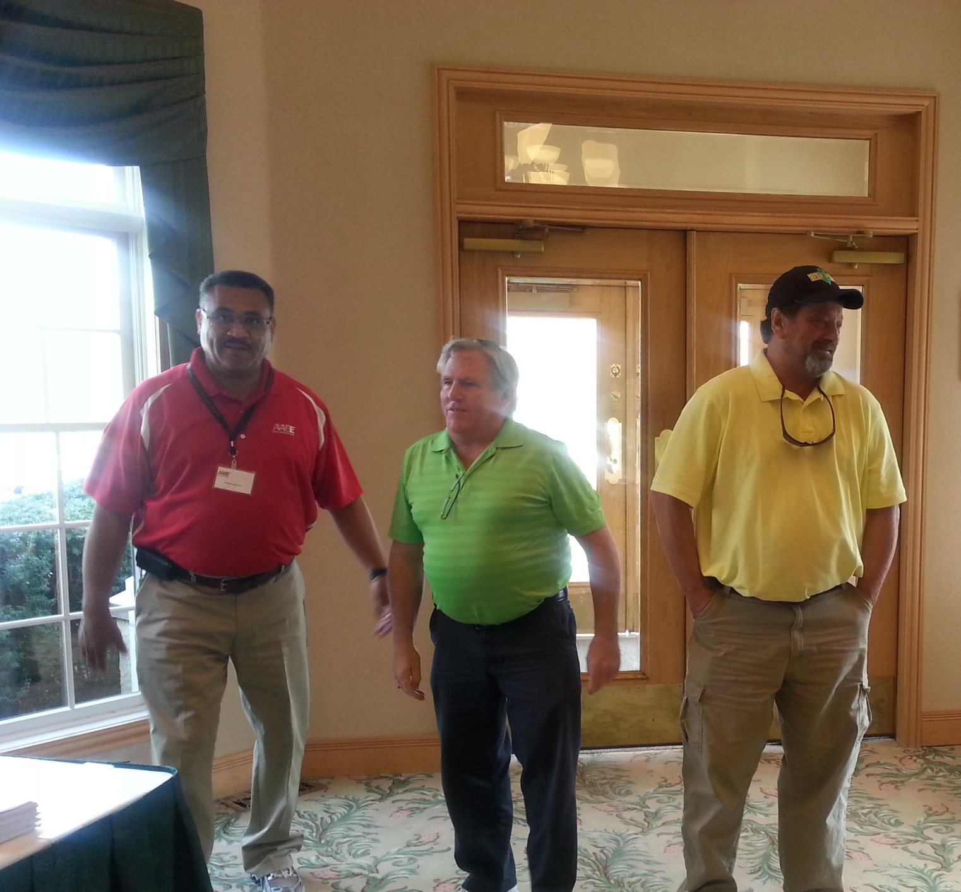
Welcome

Slide 22
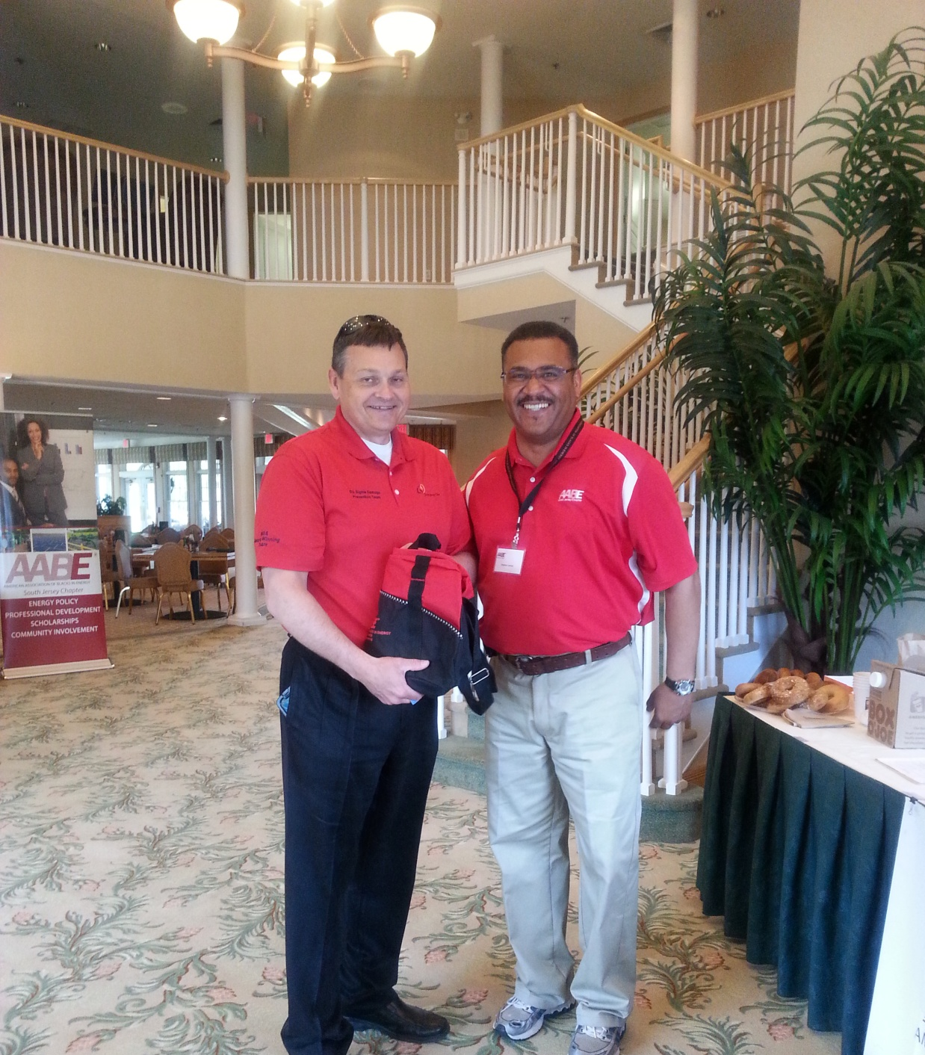
Welcome

Slide 23
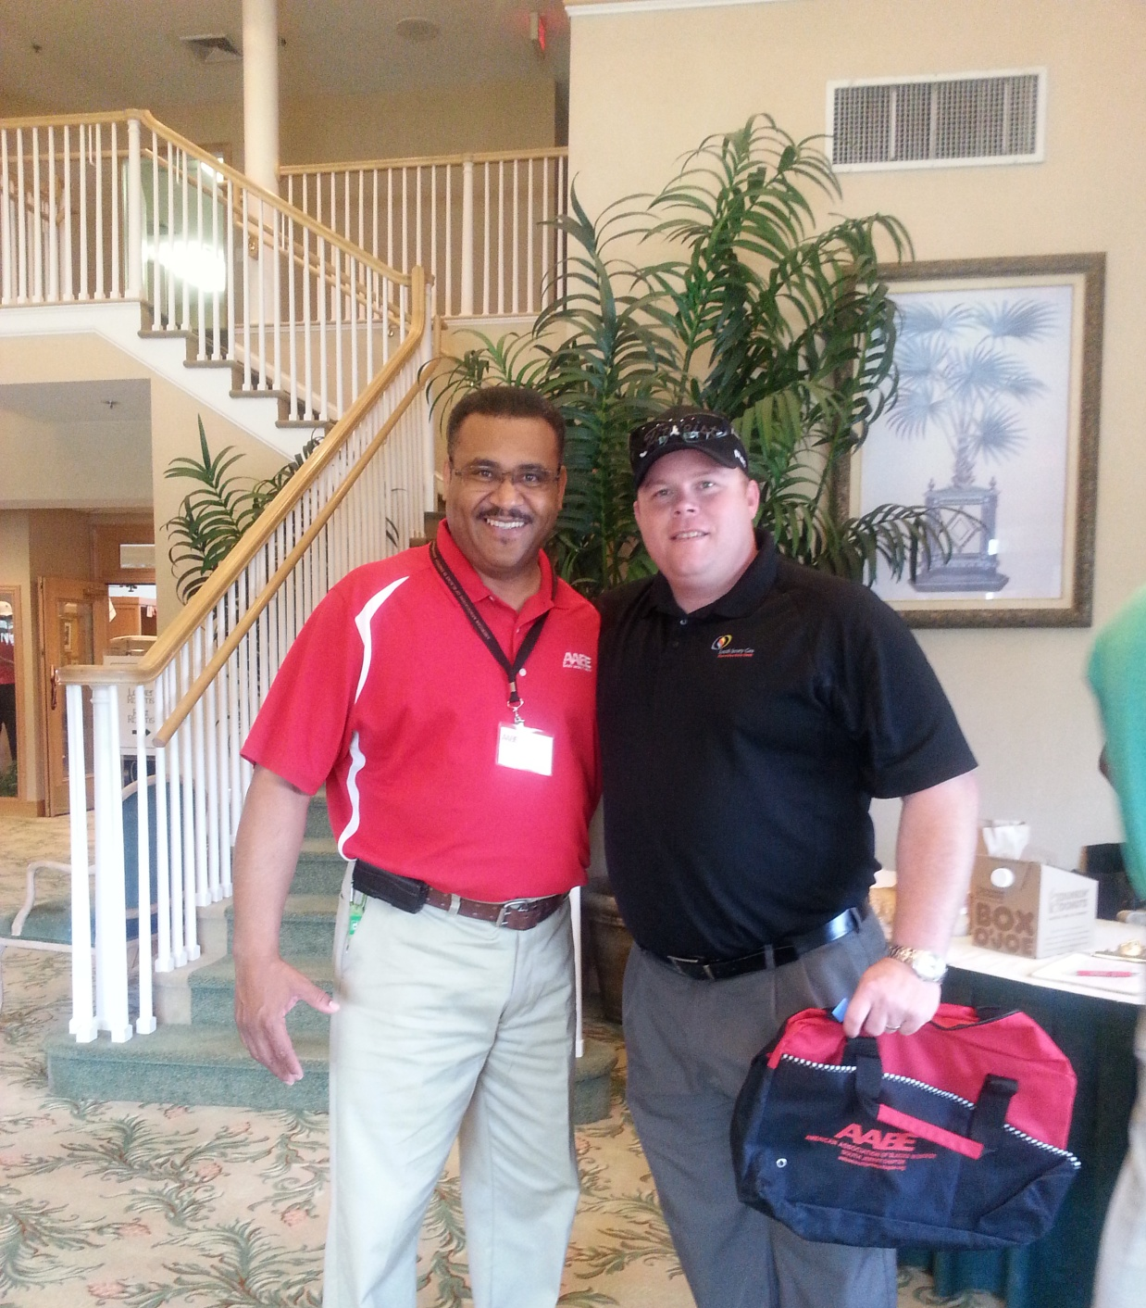
Welcome

Slide 24
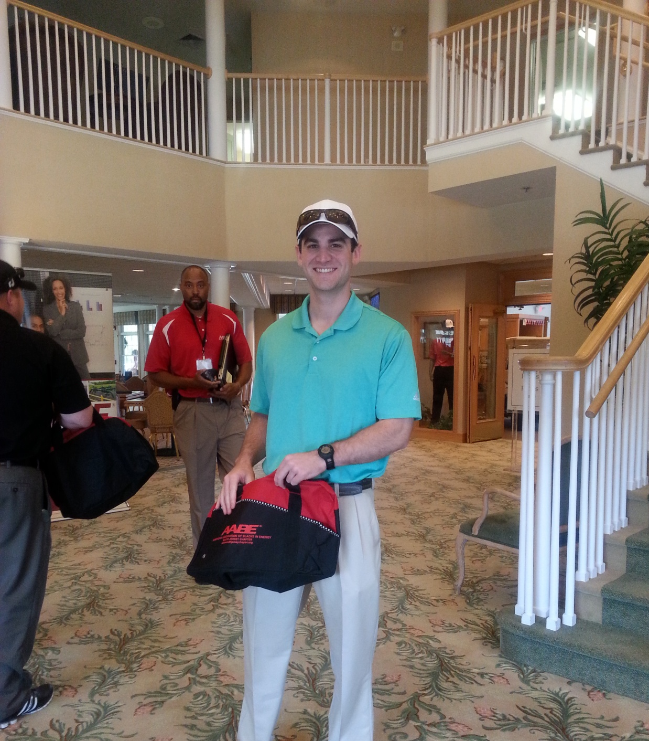
Welcome

Slide 25
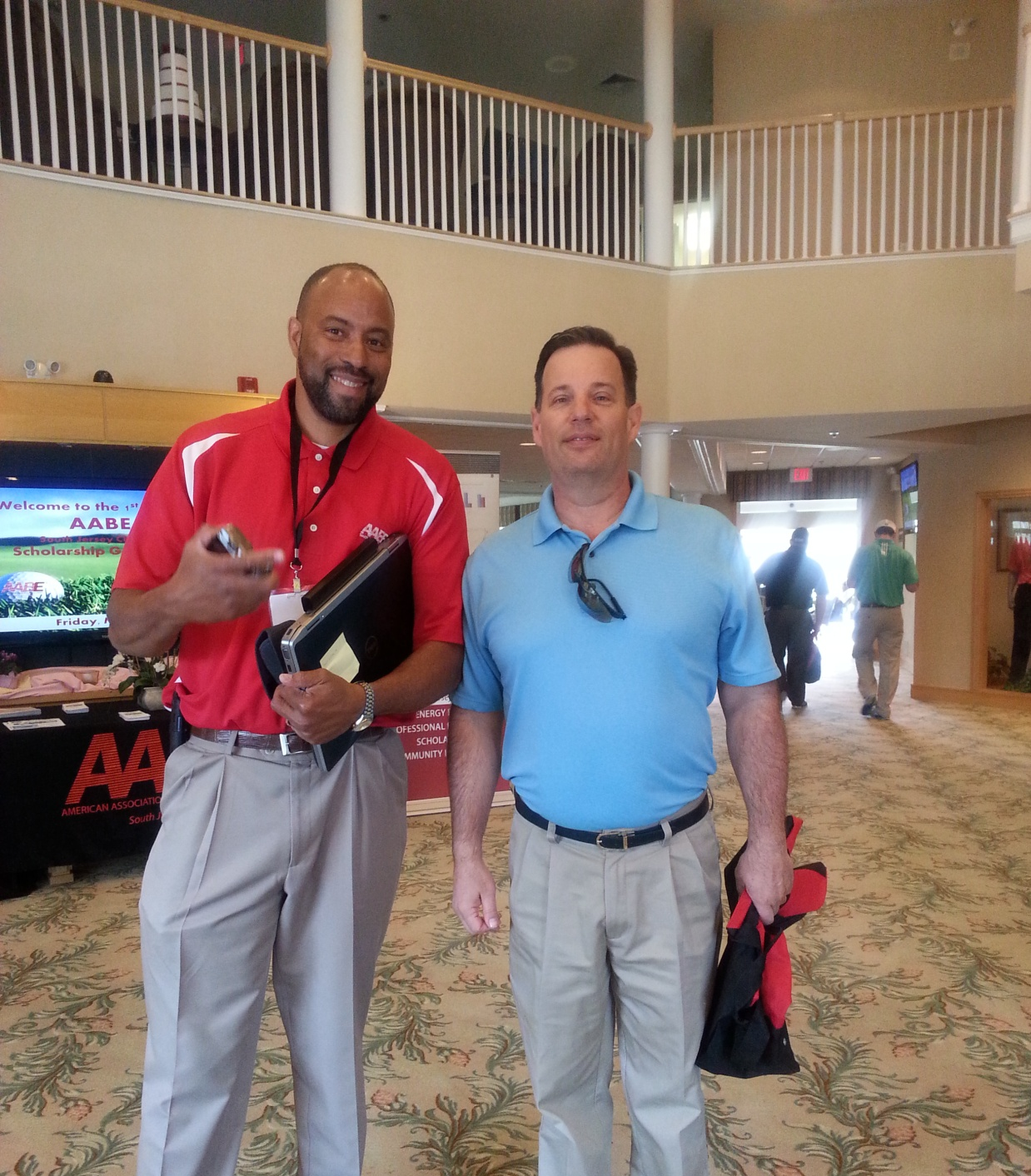
Welcome

Slide 26
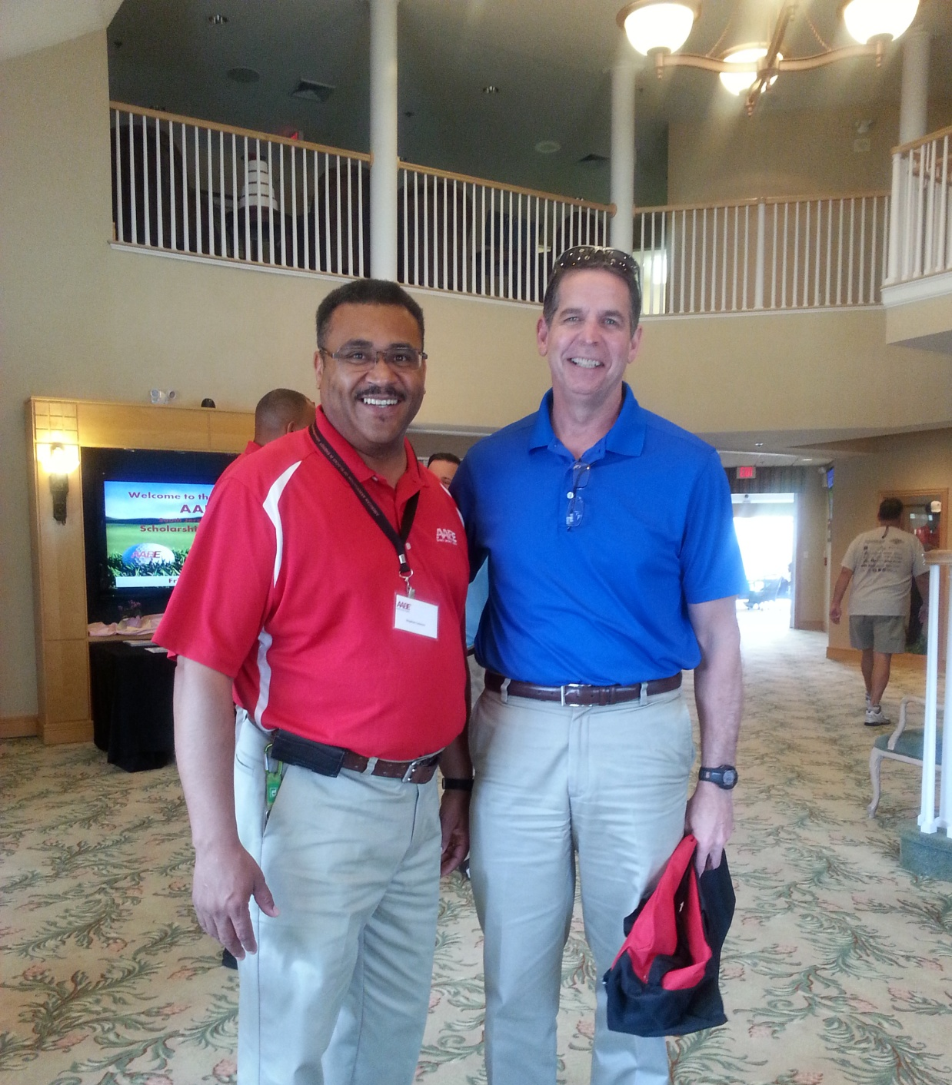
Welcome

Slide 27
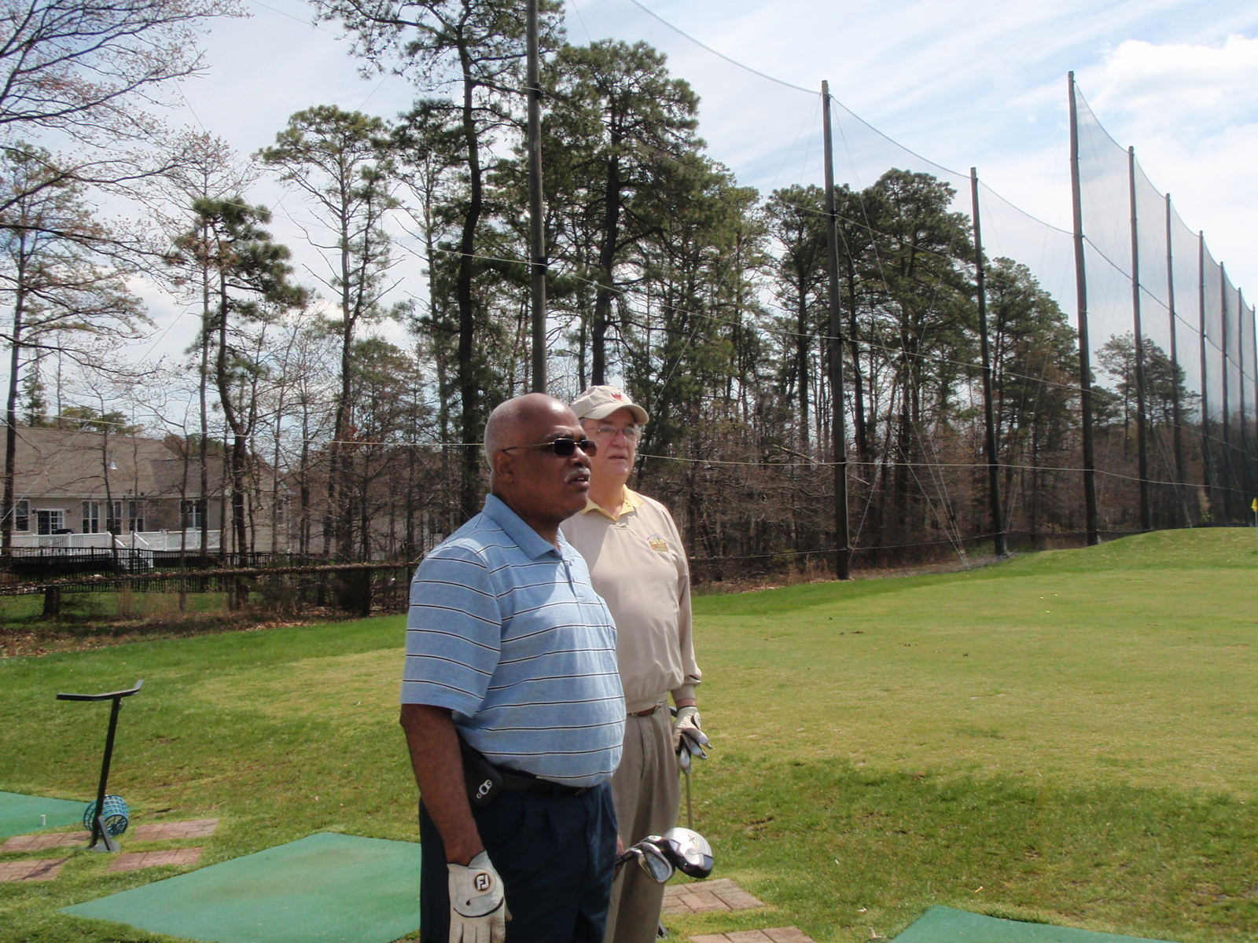
Warming Up

Slide 28
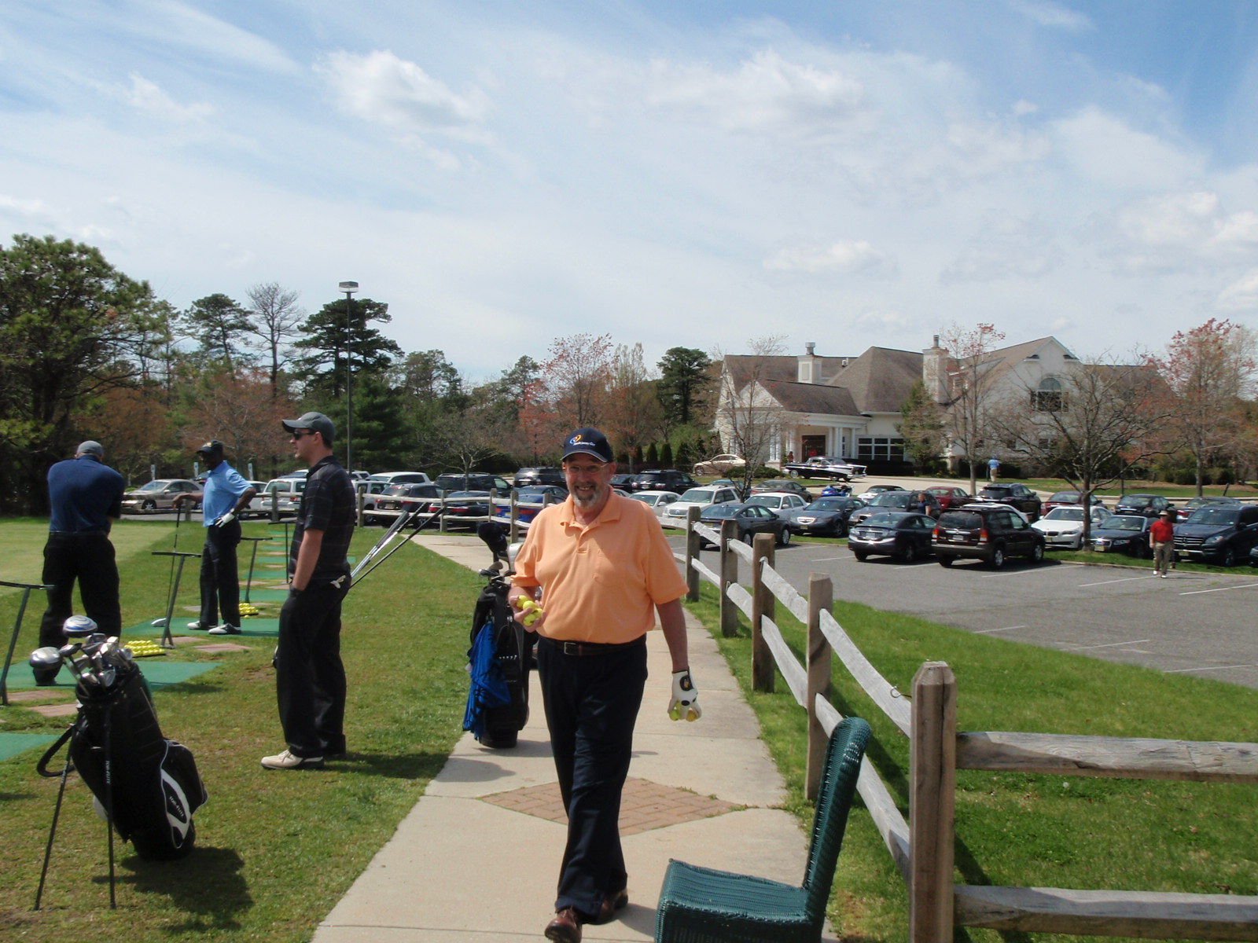
Warming Up

Slide 29
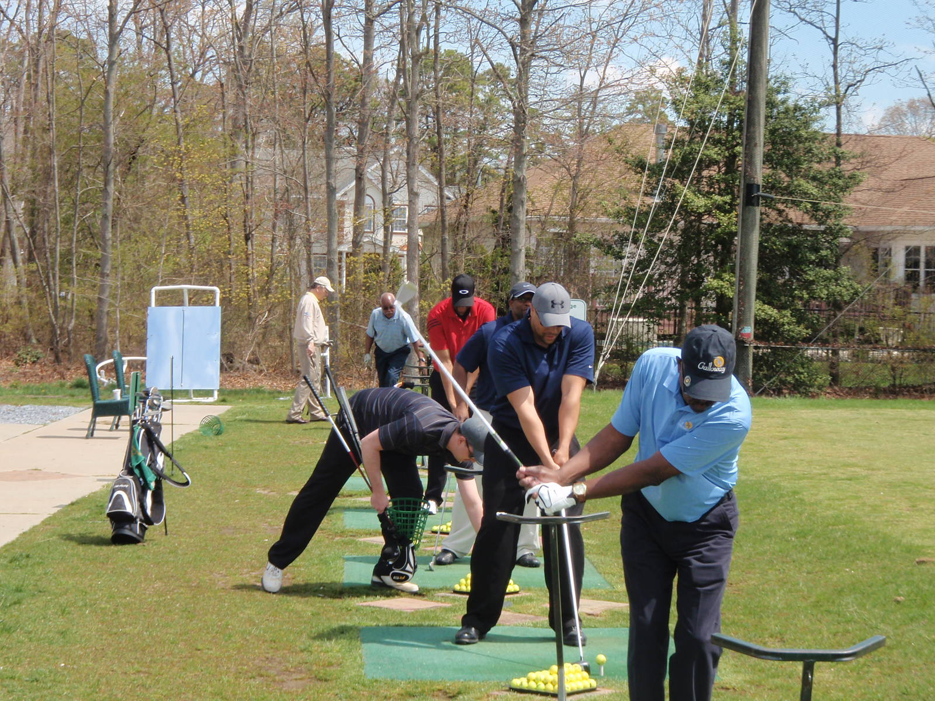
Warming Up

Slide 30
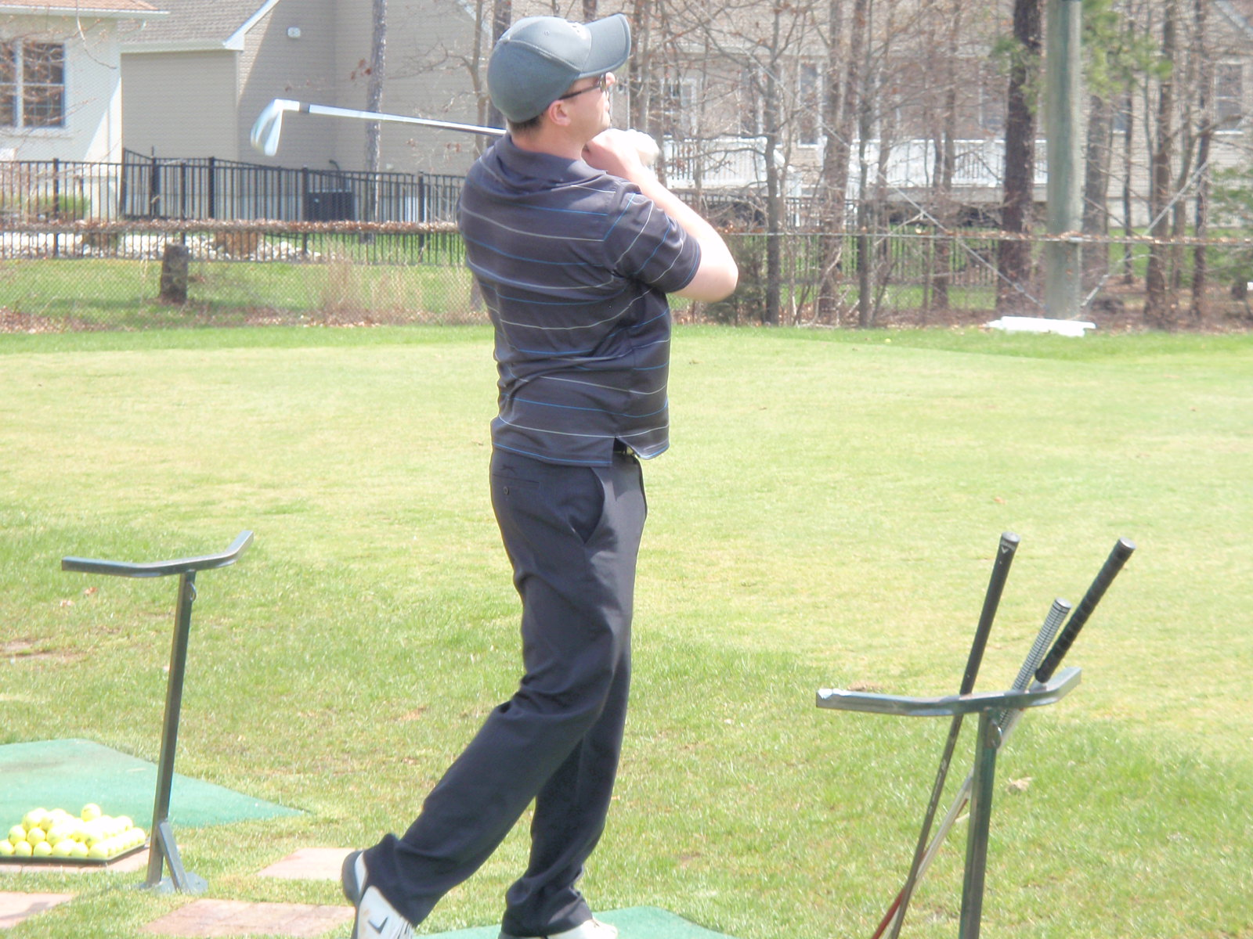
Warming Up

Slide 31
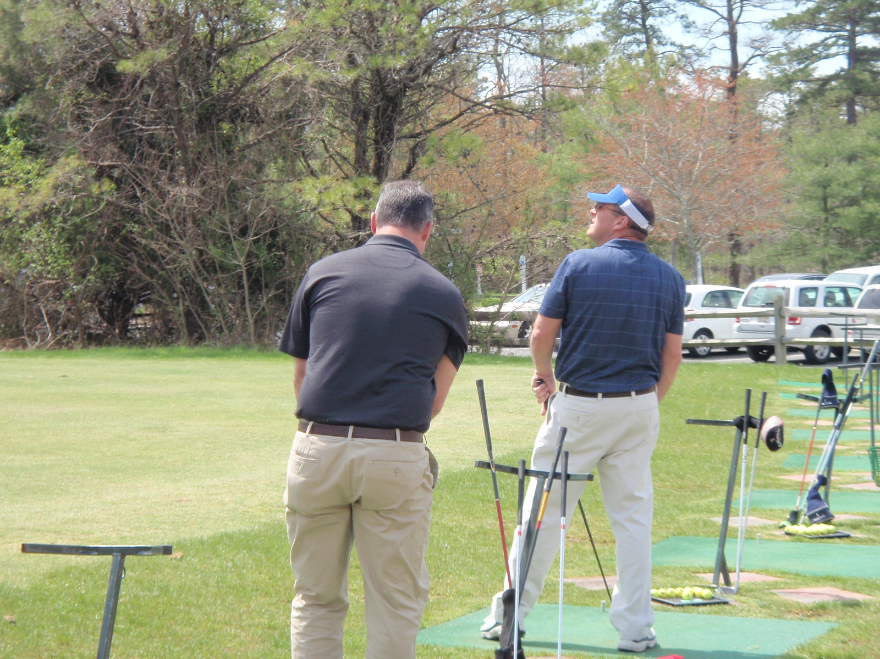
Warming Up

Slide 32
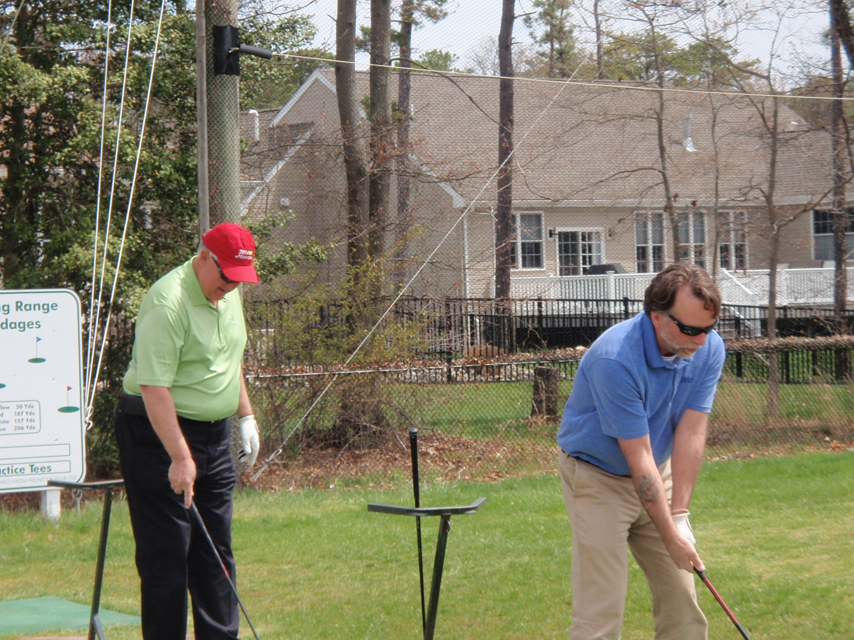
Warming Up

Slide 33
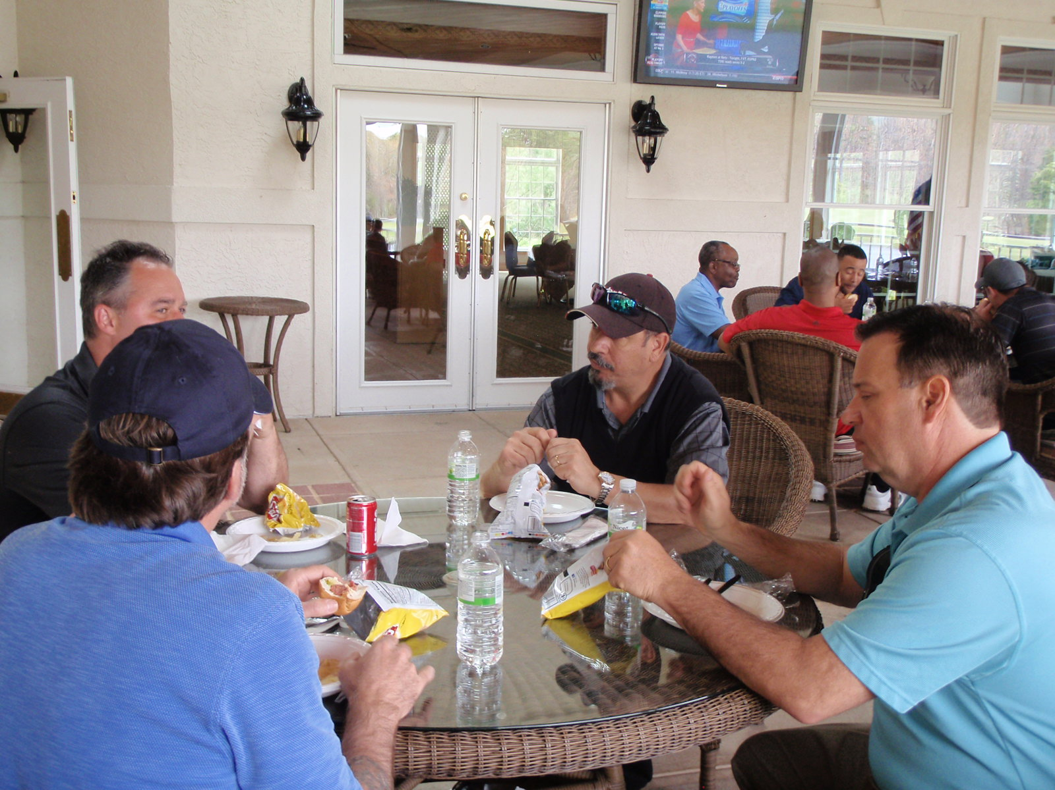
Luncheon

Slide 34
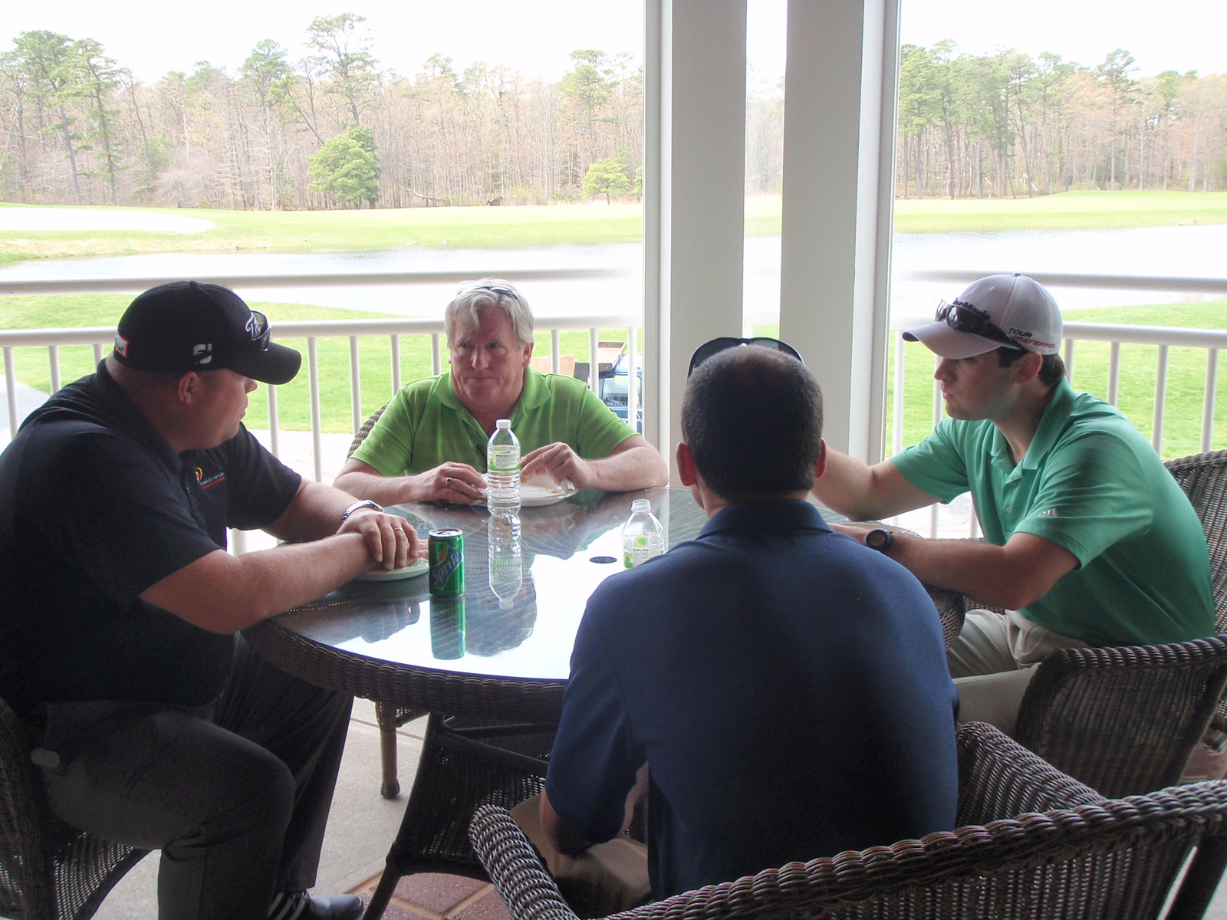
Luncheon

Slide 35
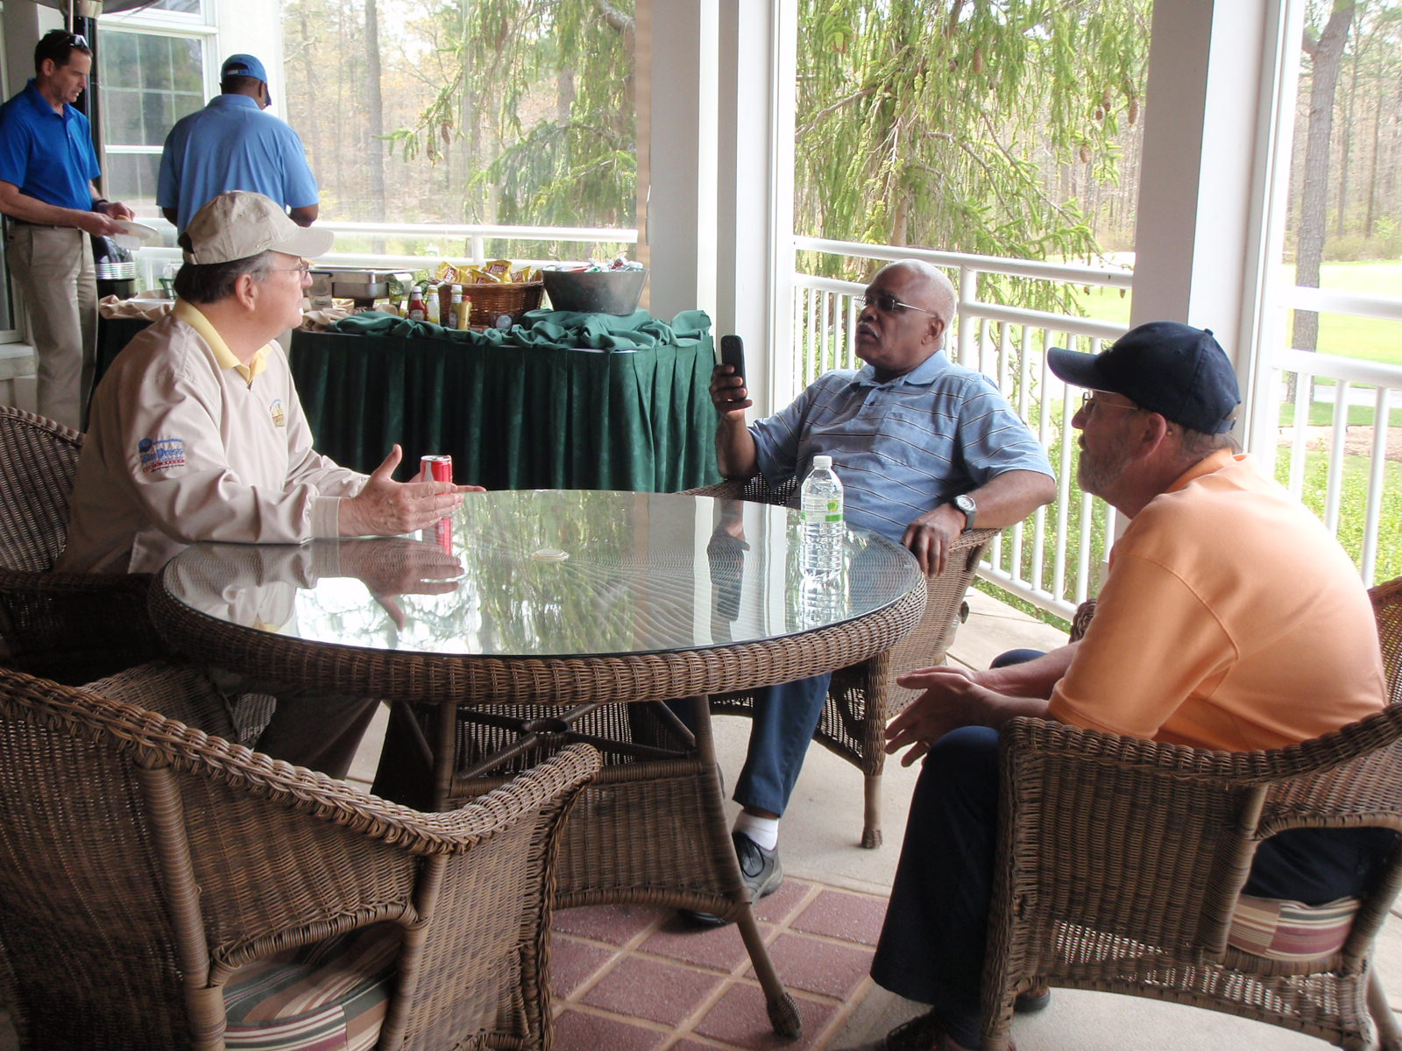
Luncheon

Slide 36
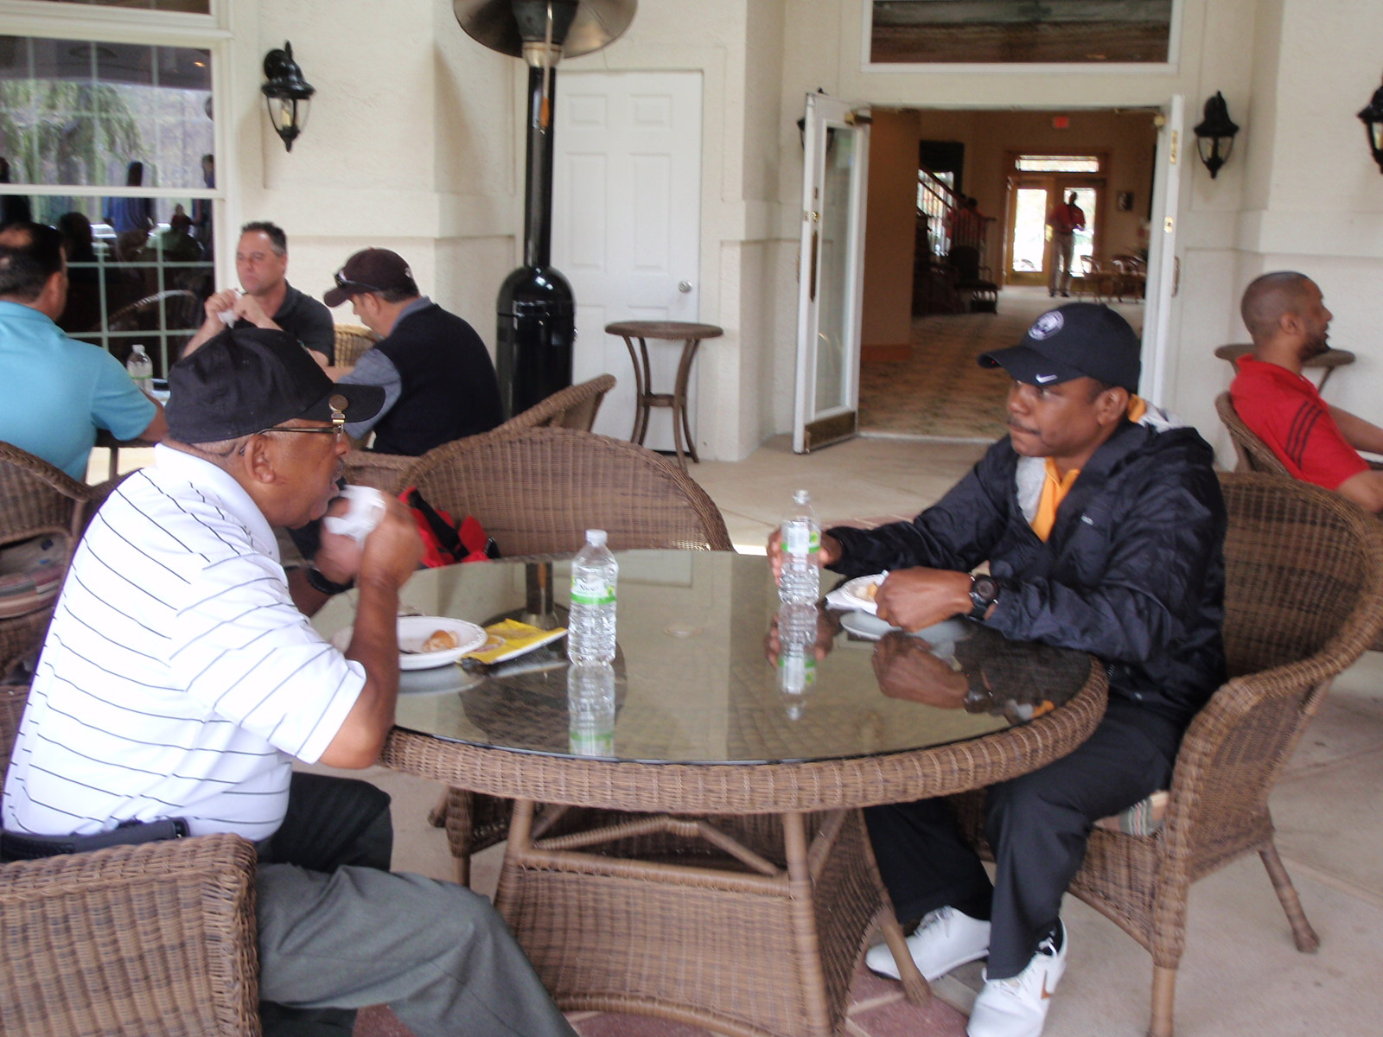
Luncheon

Slide 37
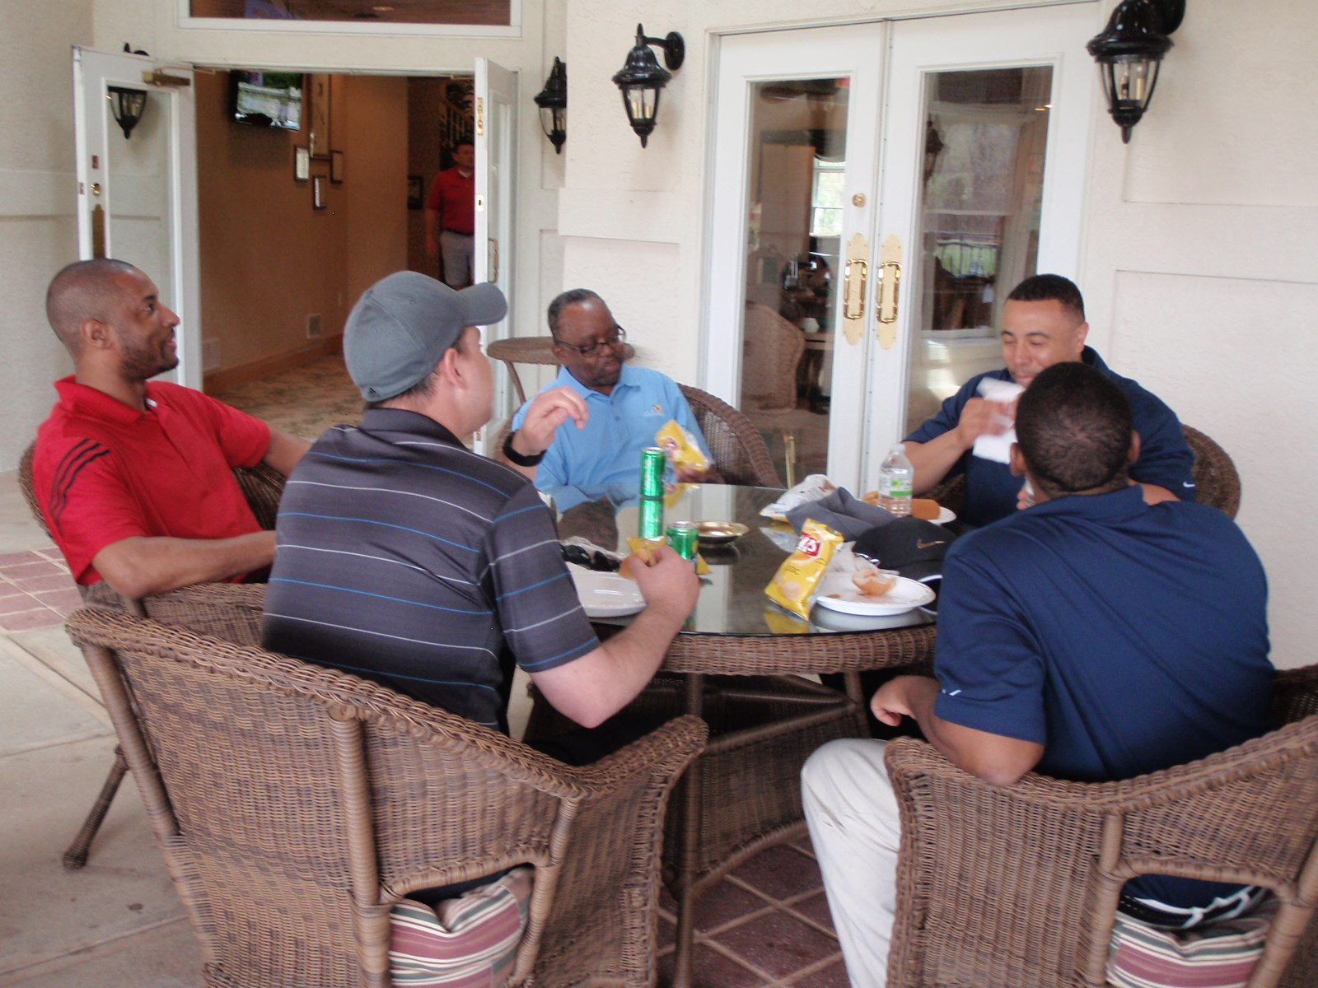
Luncheon

Slide 38
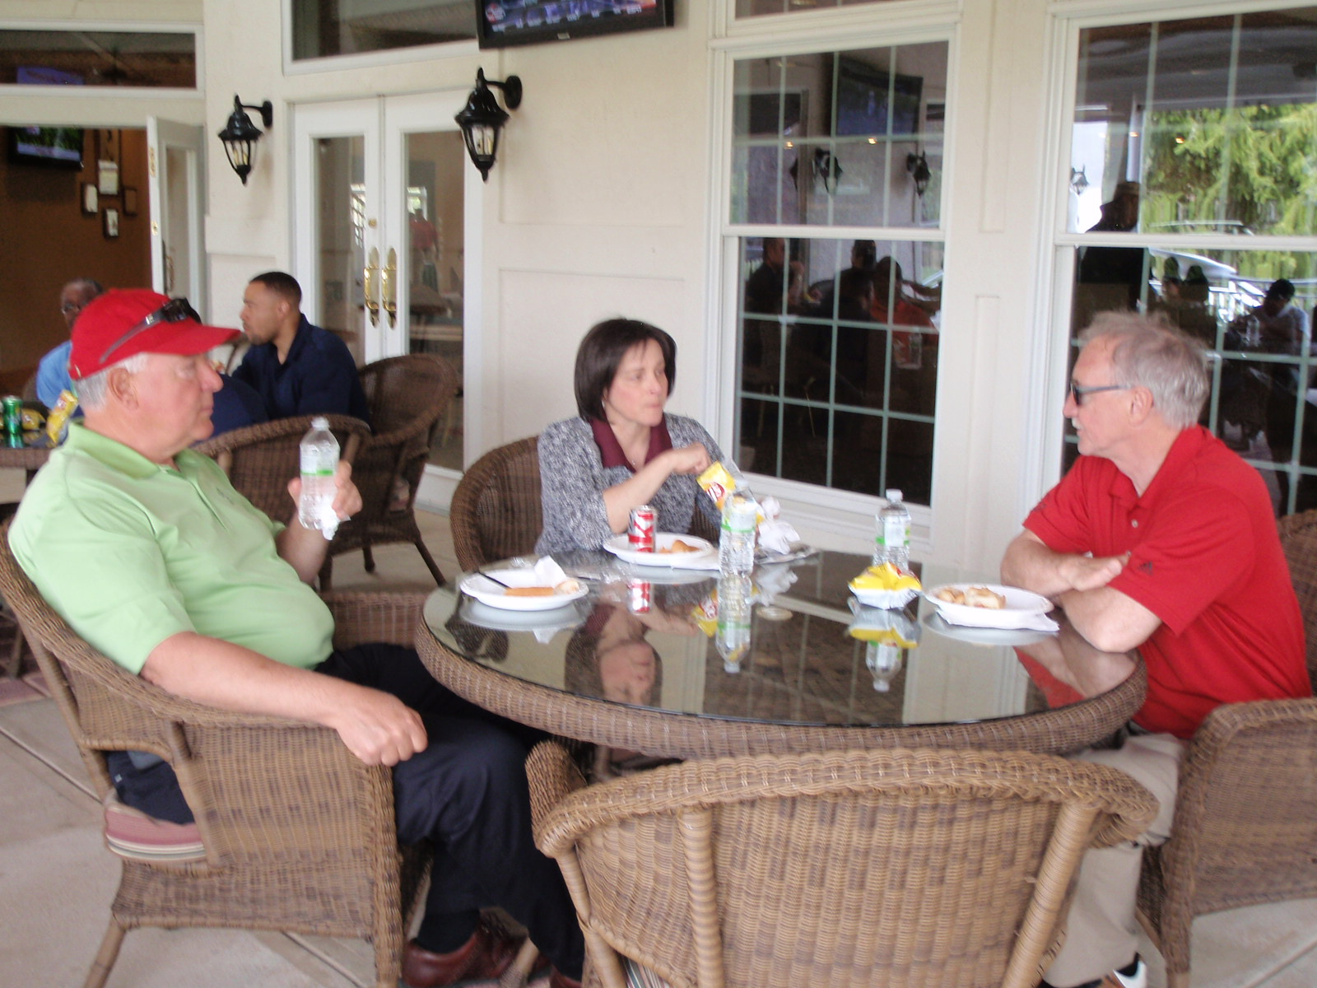
Luncheon

Slide 39
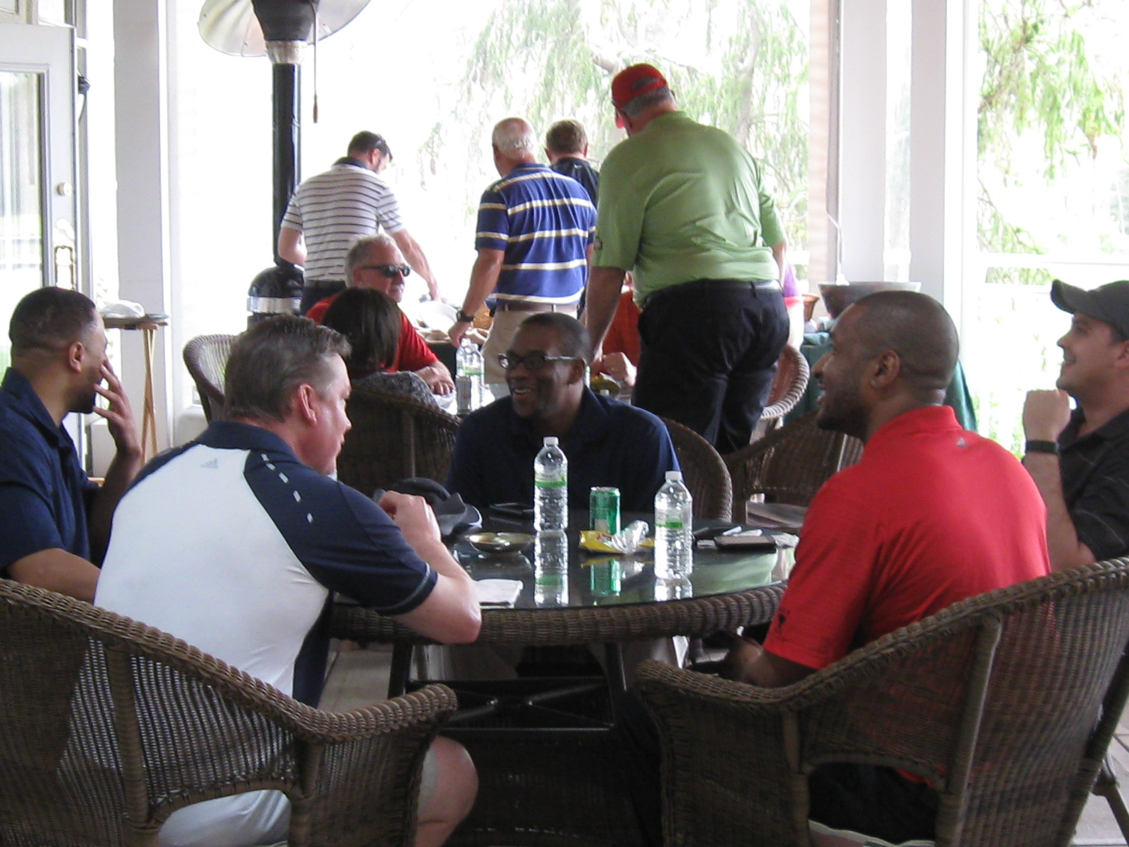
Luncheon

Slide 40
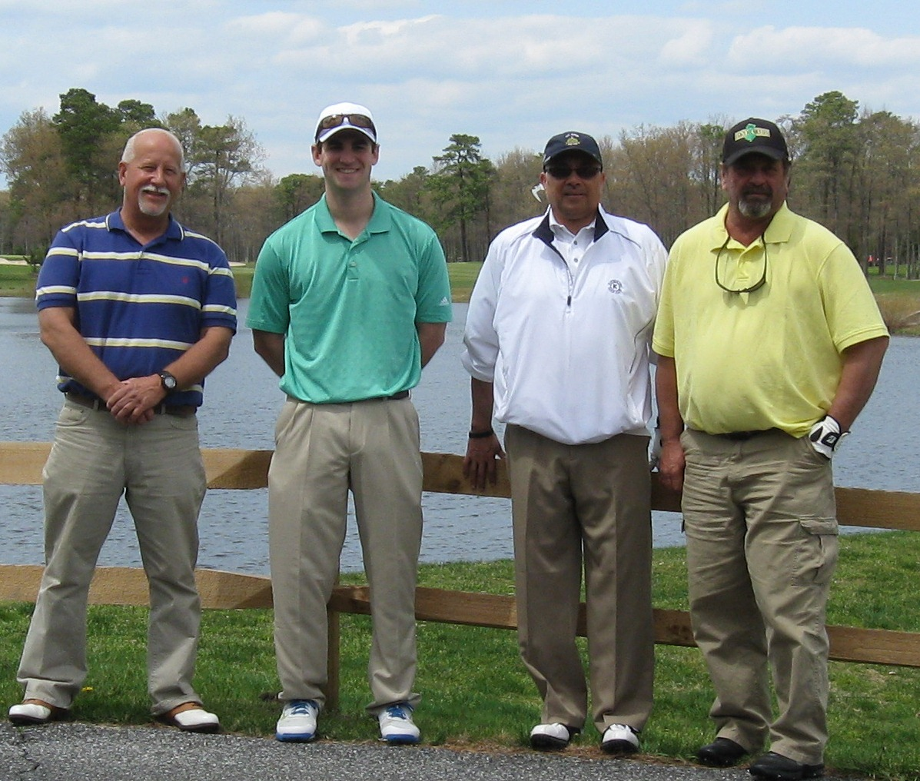
Foursomes

Slide 41
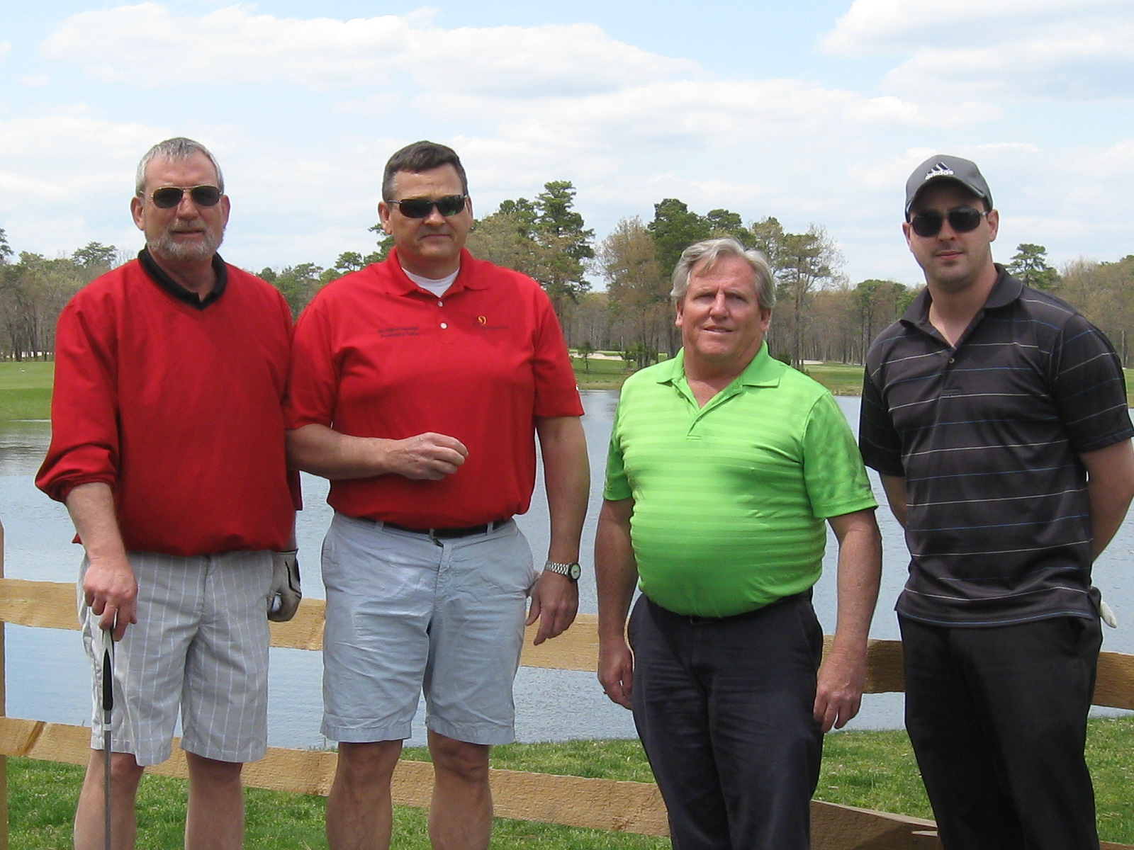
Foursomes

Slide 42
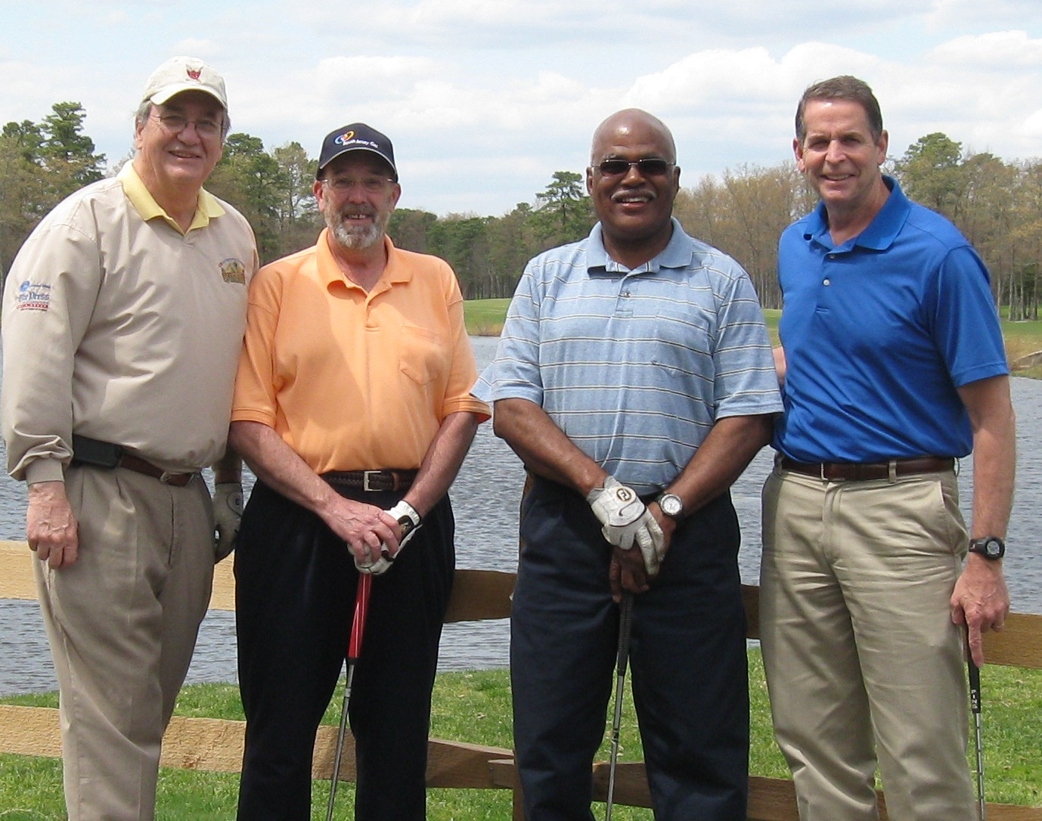
Foursomes

Slide 43
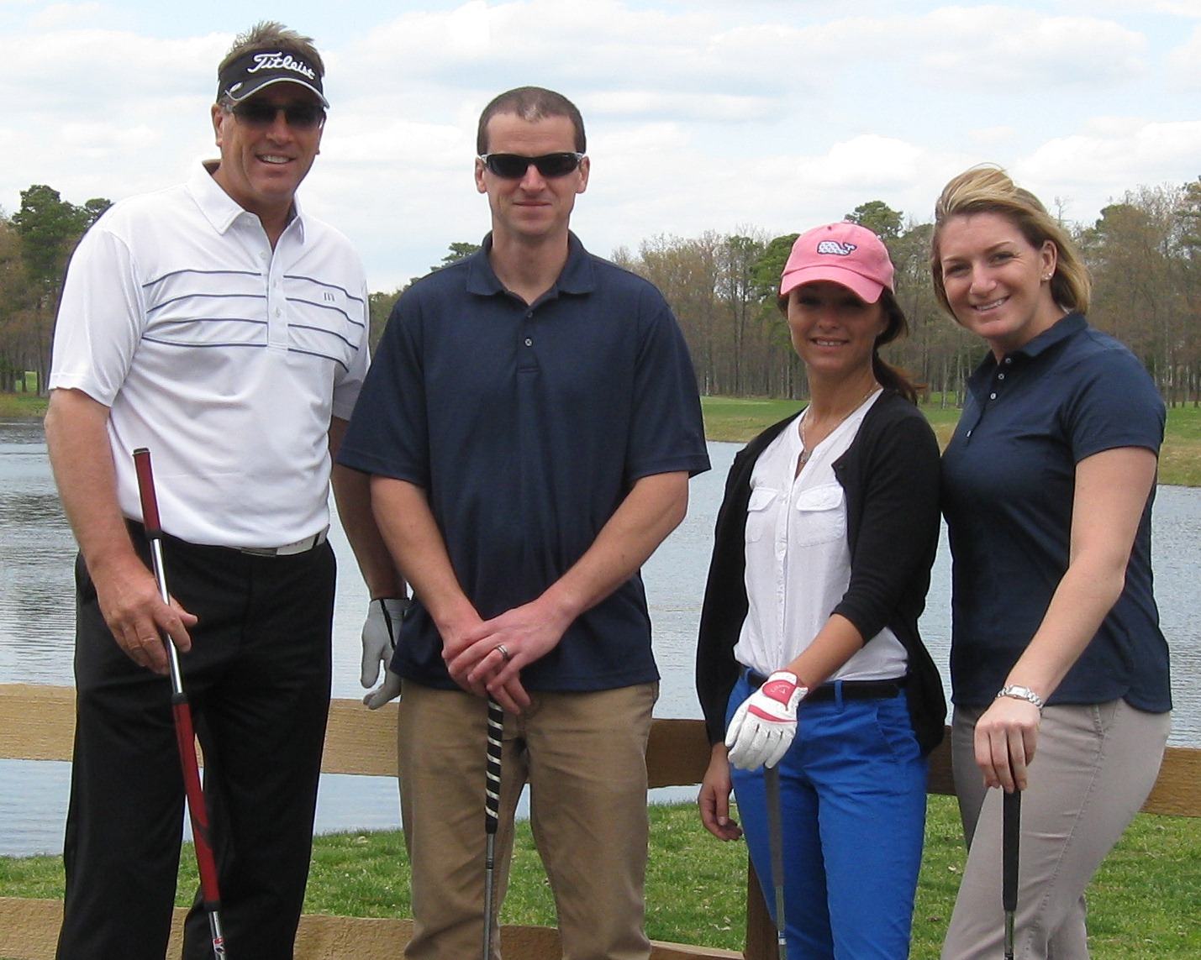
Foursomes

Slide 44
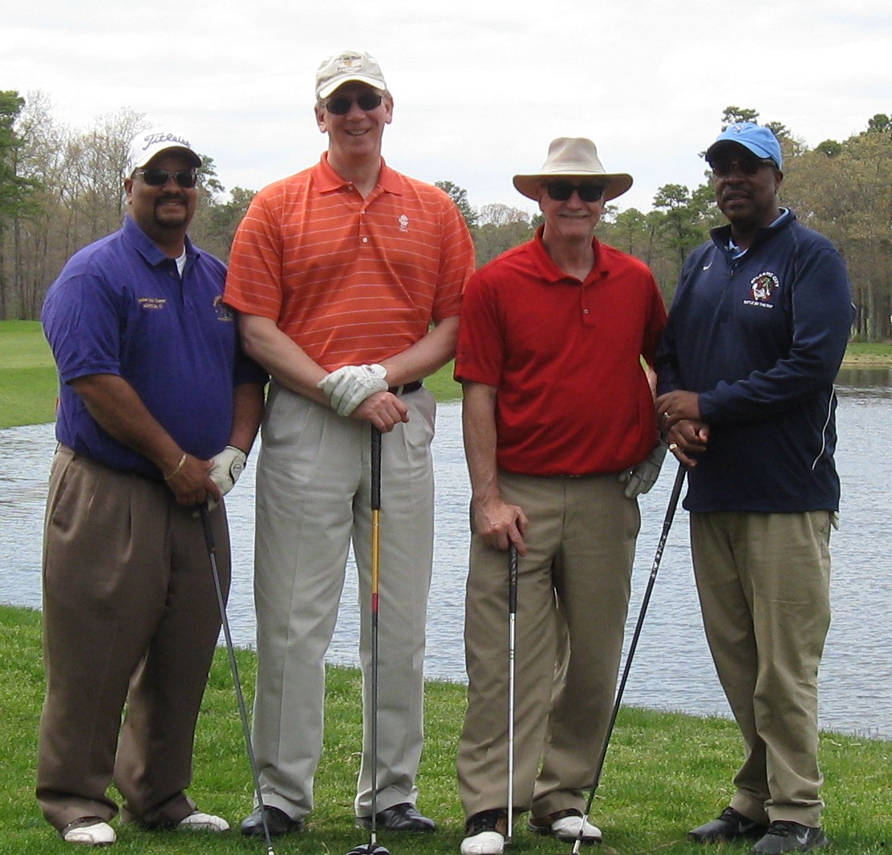
Foursomes

Slide 45
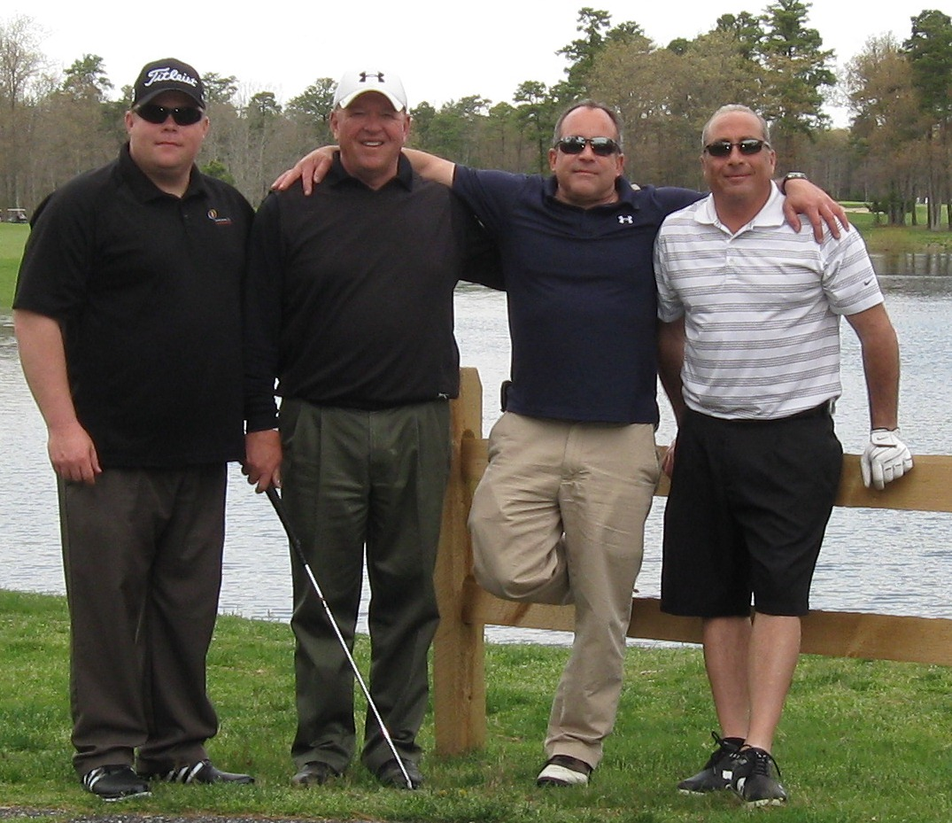
Foursomes

Slide 46
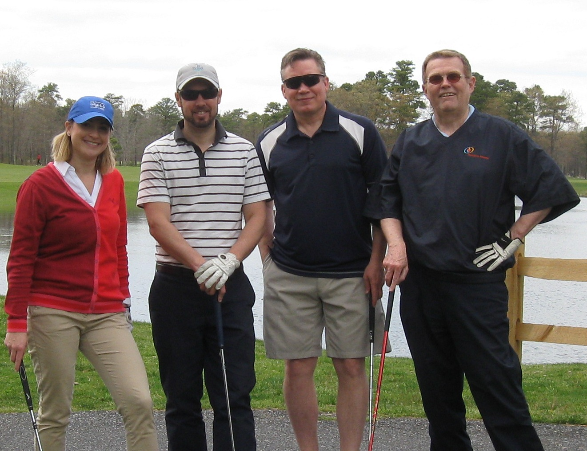
Foursomes

Slide 47
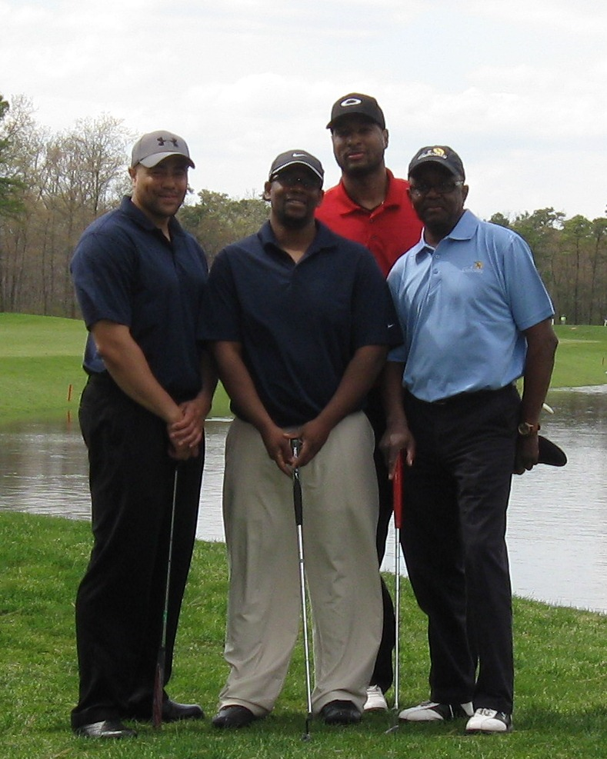
Foursomes

Slide 48
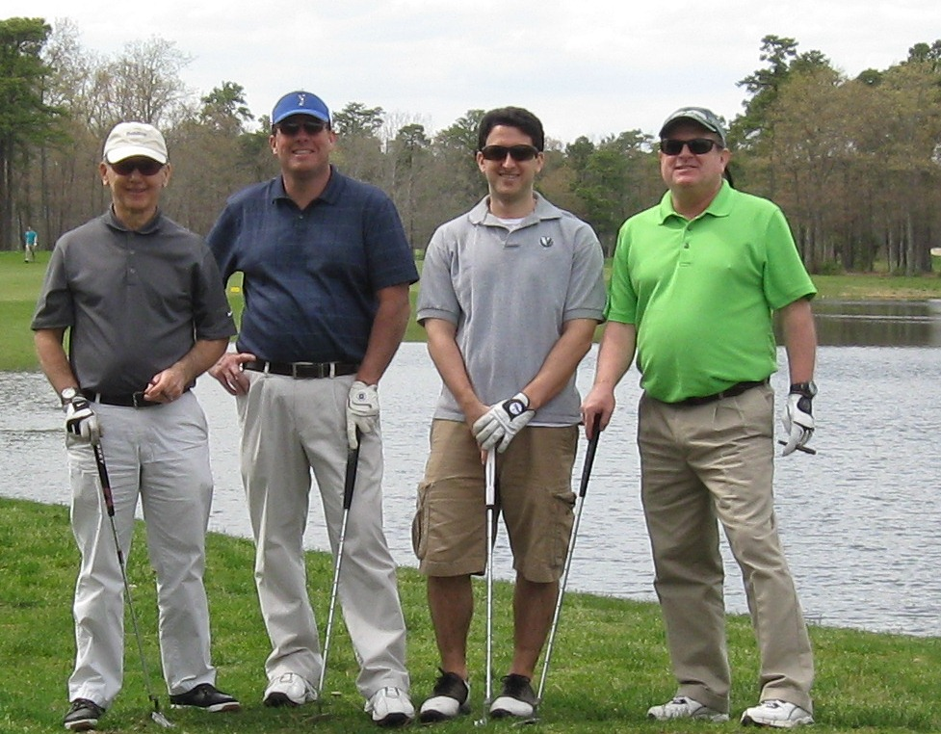
Foursomes

Slide 49
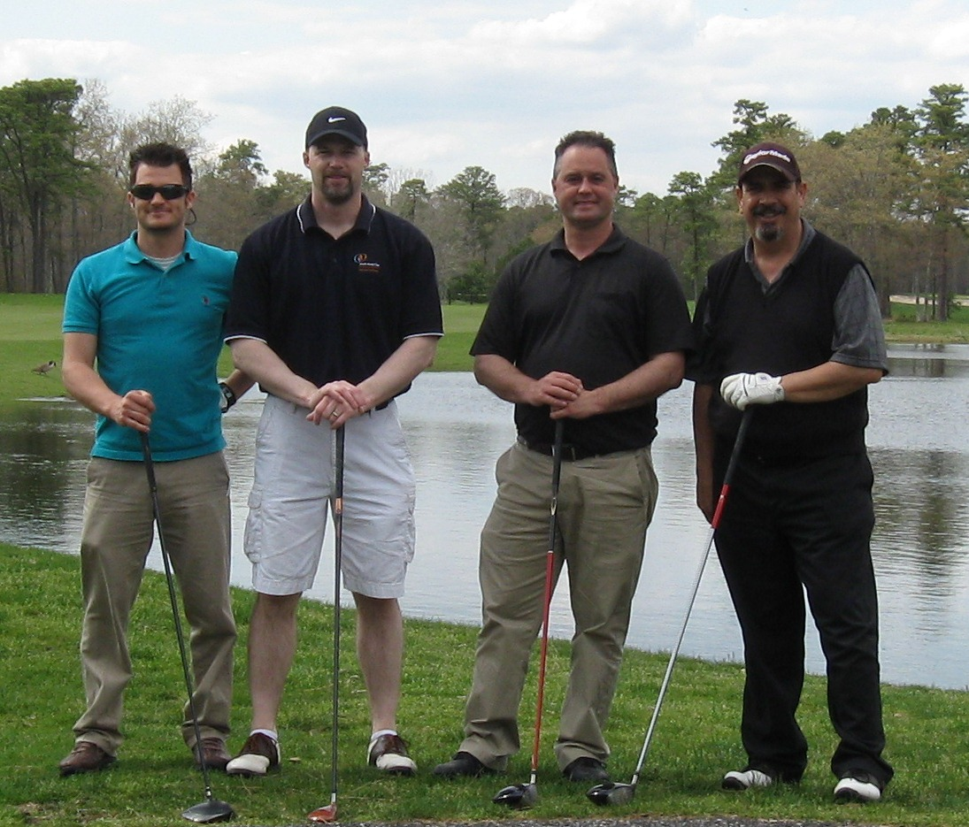
Foursomes

Slide 50
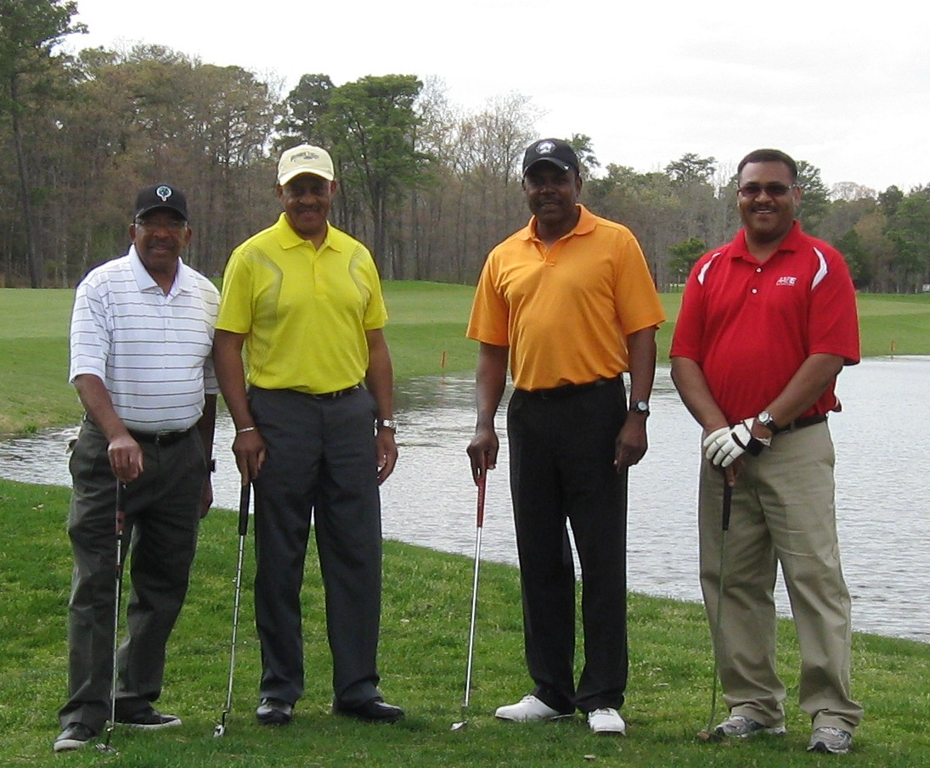
Foursomes

Slide 51

Foursomes

Slide 52

Honoring Vince Jackson

Slide 53

Stephen Clark accepting award for Dave Kindlick

Slide 54

Third Place Foursome

Slide 55

First Place Foursome

Slide 56

Scholarship Banquet

Slide 57

Scholarship Recipient Deija Grier daughter of Delta Grier

Slide 58

Door Prize Winner

Slide 59

Door Prize Winner

Slide 60

Door Prize Winner

Slide 61

Kyle Nolan won Longest Drive

Slide 62

Bubba accepting award of Closes to the Pin won by Paul Zuccarino

Slide 63

Winner of Putting contest

Slide 64

Scholarship Banquet

